Slide 1


Regeltechniek WPO –
Control engineering exercises
Dr. ir. Péter Zoltán Csurcsia

Slide 2
In case of problems
In case of problems: peter.zoltan.csurcsia@vub.be
Website:
http://homepages.vub.ac.be/~pcsurcsi
For appointments: agenda online available

Slide 3
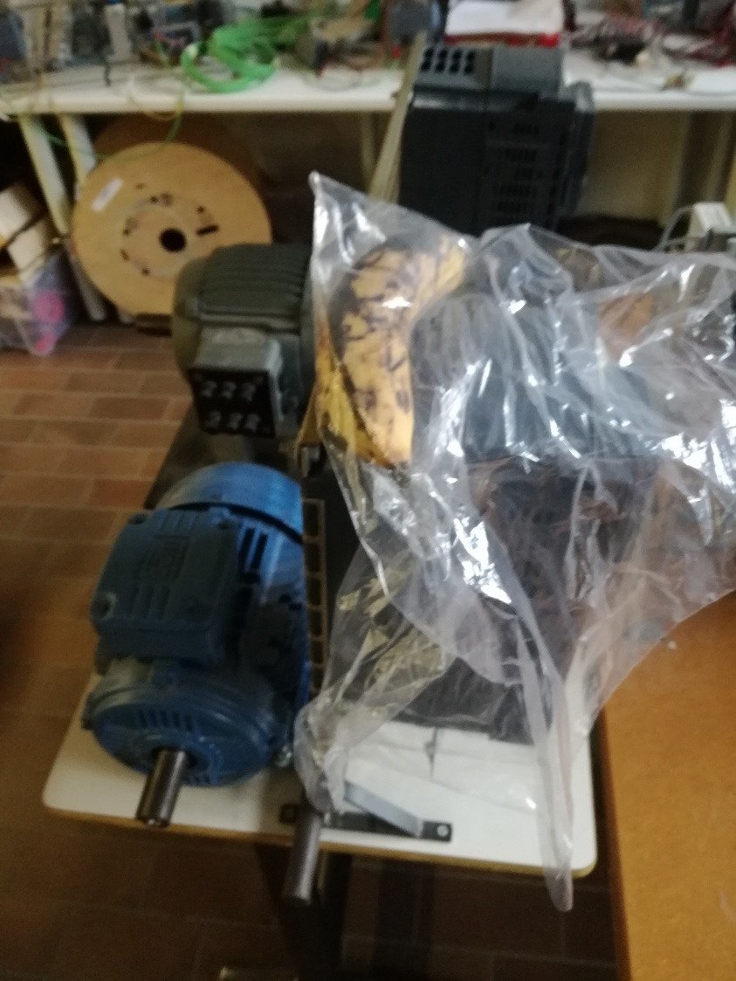
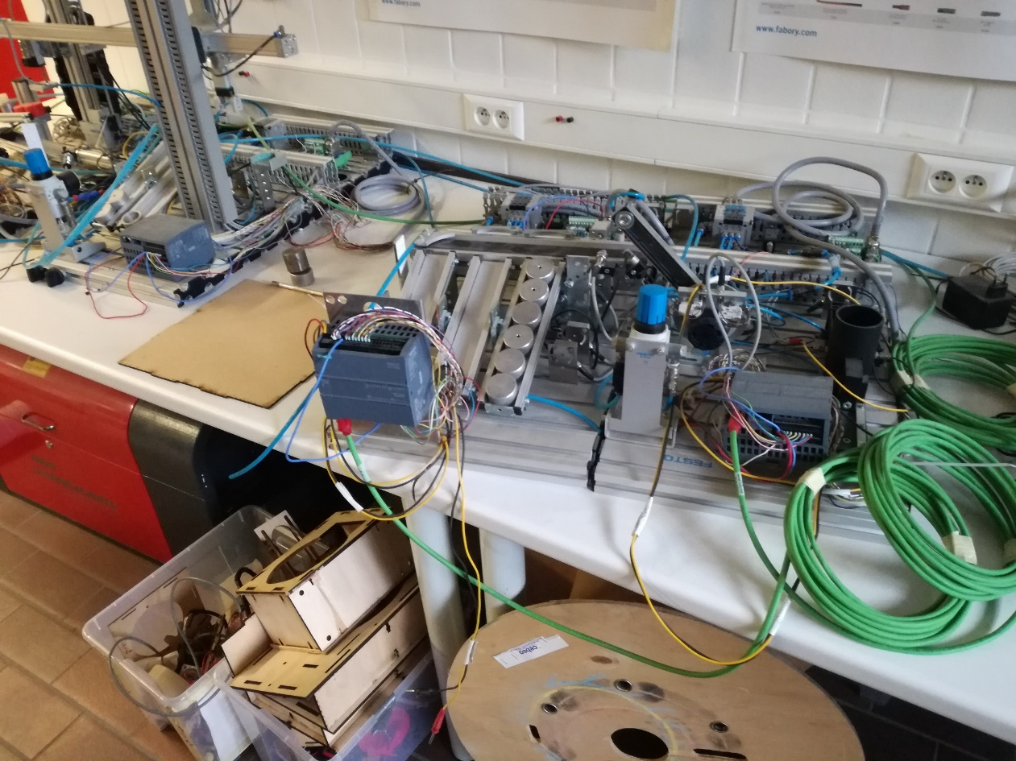
Why no ‘real’ lab exercises?

Slide 4

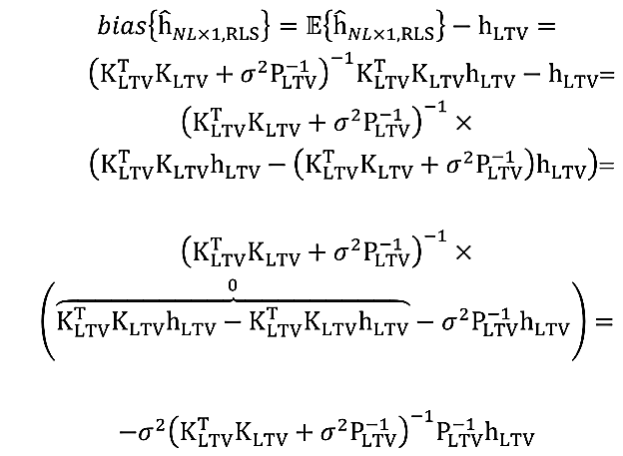
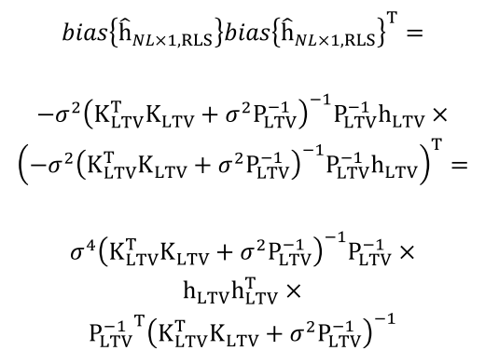
What will be instead?
Theoretical analysis and
mathematical derivation

Slide 5
What will we learn?
Very basics only:
  Systems <> models
  Excitation signals
  Some of the most popular analysis techniques:
  Bode plot, step responses…
  Open and closed loop control
Tools
  Whiteboard v0.0
  Control engineering toolbox (MATLAB)
  Simulink toolbox (MATLAB)

Slide 6

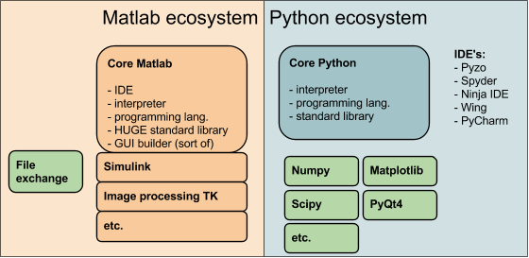
Matlab vs Phython
Control systems
Control systems

Slide 7
About the exercises: 4 sessions
1) Starting up: Matlab-control engineering toolbox
  Report writing, can work in a group of 2-3
2) Control engineering toolbox
  Paper based test for 5 points
  Report writing to regeltechniekwpo@gmail.com, can work in a group of 2-3
3) More theoretical-control engineering toolbox
  Paper based test for 5 points
  Report writing to regeltechniekwpo@gmail.com, can work in a group of 2-3
4) Simulink toolbox
  Paper based test for 5 points
  Pratical test to be organized
  Simulink test for 5 points
  WPO is 30% of the total. You can carry your points if you have min. 10.

Slide 8
About myself
BEng in EE: Instumentation and measurement
BSc in technical informatics
Teacher’s diploma
MSc in embedded systems & applied informatics
PhD and Dr. ir. in (electrical) engineering
  Research area:
    Nonlinear systems
    Vibration analysis
    Time-varying systems
    Signal processing

Slide 9
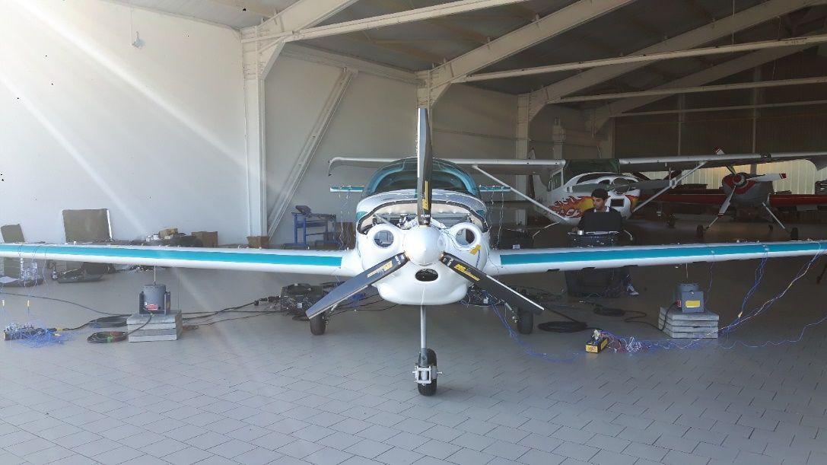
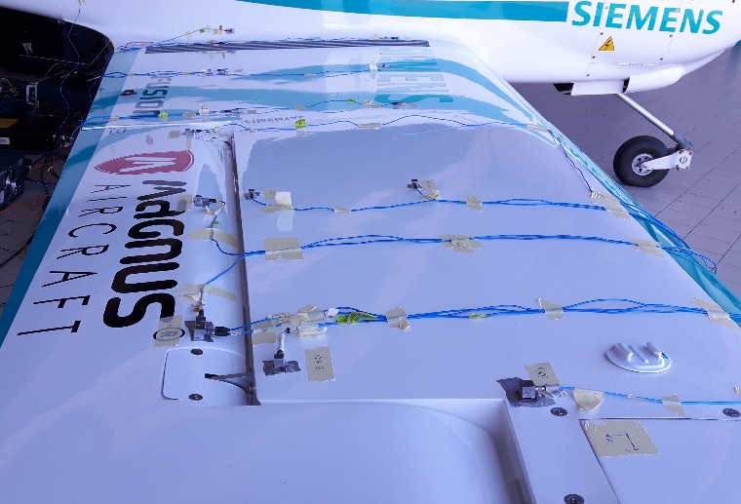
Vibarion analysis - nonlinearities
Problem 1: 100+ FRFs
Problem 2: users are not experts
Goal:
Tell the unexperienced users
1) if the system is linear
2) if it is safe to use a linear framework
3) gain in case of a nonlinear model

Slide 10
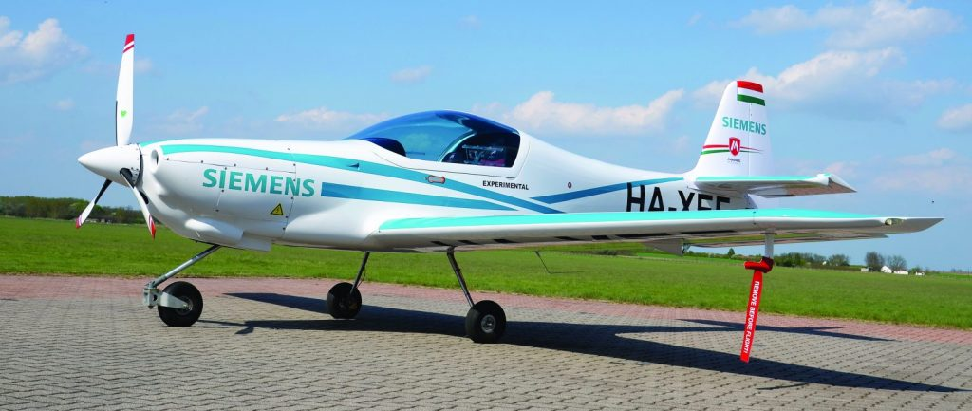
Example: GVT of an airplane
eFusion Magnus aircraft

Slide 11
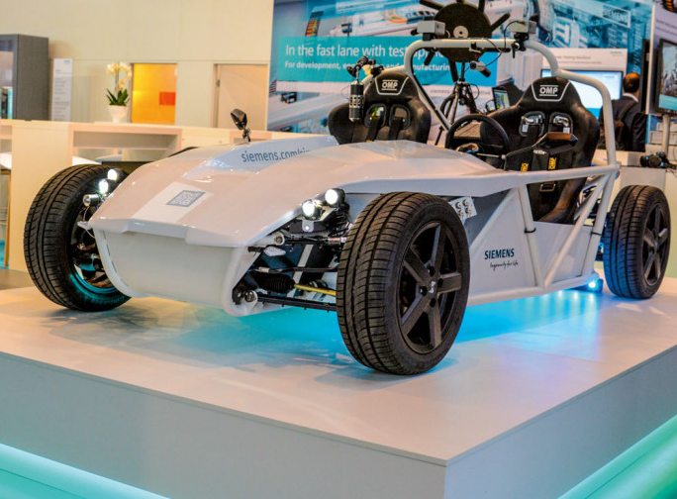
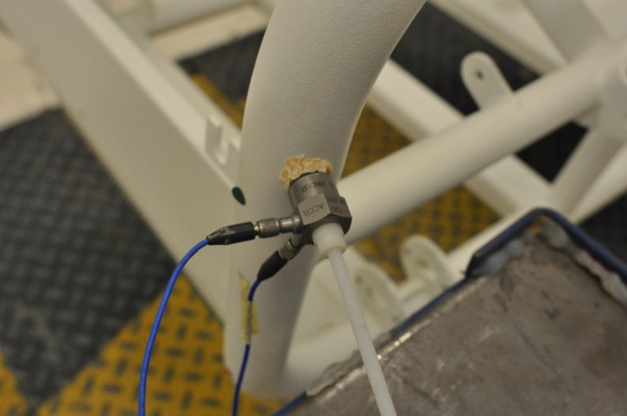
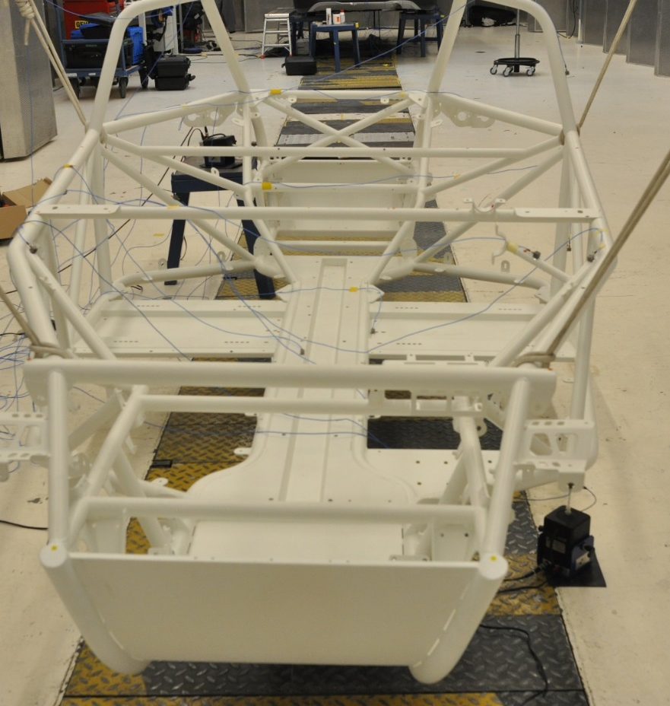

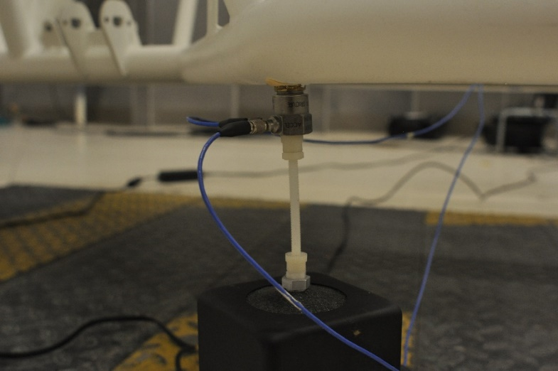
Transient elimination

Slide 12
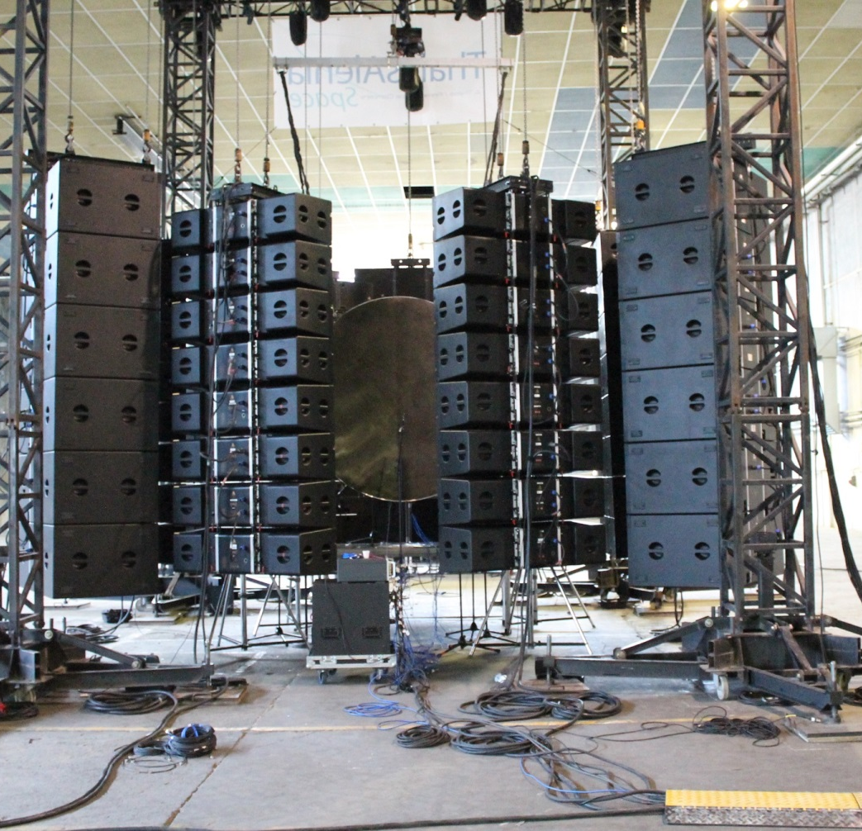
Example: DFAX
Direct Field Acoustic eXcitation issues.
Nonlinearty assesment
Control

Slide 13
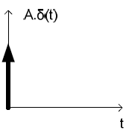
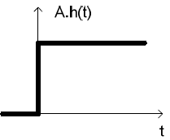
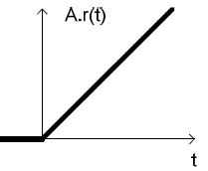
Excitation signals
u
y
SUT
Unit impulse
  The area of the impulse is one (A=1)
  Bad SNR
Unit step-signal (heavy-side function)
  Old-school most-often used
  Height of the signal is 1 (A=1)
  Better SNR but high frequencies are not well excited
Unit ramp-signal
  Slope of the ramp signal is 1 (A=1)
Parabolic
Sine/cosine
Noise
…

Slide 14
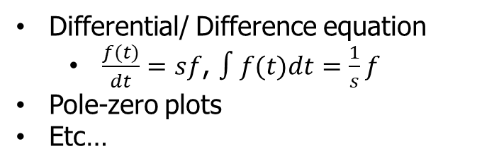
Models in general
Time domain
Fourier
Frequency domain
$$s=jω$$
𝑠=𝑗𝜔
Laplace domain
Laplace
Differential/ Difference equation
State-space equations
Impulse response (measurements)
Step response (measurements)
Ramp response (measurement)
Etc…
Differential/ Difference equation
  $\frac{f(t)}{dt}=sf$, $∫f(t)dt=\frac{1}{s}f$
Pole-zero plots
Etc…
Frequency Response Function
Bode plot
Nyquist plot
Etc…

Slide 15


Models in the WPO session
Time domain
Fourier
Frequency domain
$$S=jω$$
𝑆=𝑗𝜔
Laplace domain
Laplace
Impulse response
Step response
Bode plot
Differential equations
  Transfer function form
  Zero Pole Gain form
Pole-zero plots

Slide 16
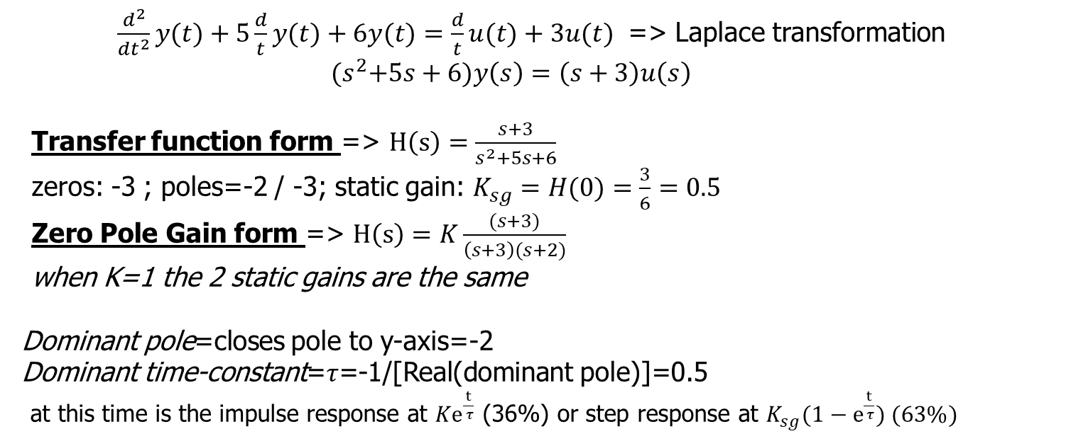
Differential equation example
$\frac{d^{2}}{dt^{2}}y(t)+5\frac{d}{t}y(t)+6y(t)=\frac{d}{t}u(t)+3u(t)$ => Laplace transformation
${(s}^{2}+5s+6)y\left(s\right)=\left(s+3\right)u\left(s\right)$
  Transfer function form => $H\left(s\right)=\frac{s+3}{s^{2}+5s+6}$
  zeros: -3 ; poles=-2 / -3; static gain: $K_{sg}=H(0)=\frac{3}{6}=0.5$
  Zero Pole Gain form => $H\left(s\right)=K\frac{(s+3)}{\left(s+3\right)(s+2)}$
  when K=1 the 2 static gains are the same
  Dominant pole=closes pole to y-axis=-2
  Dominant time-constant=$τ$=-1/[Real(dominant pole)]=0.5
  at this time is the impulse response at ${Ke}^{\frac{t}{ τ}}$ (36%) or step response at ${K_{sg}(1−e}^{\frac{t}{ τ}}) (63\%)$

Slide 17
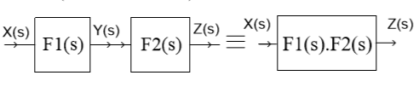
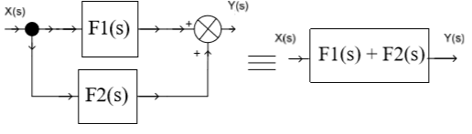
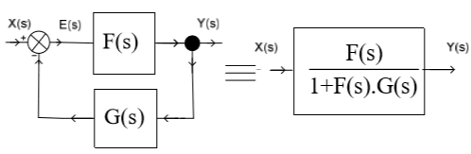
Connecting blocks - book
Serial connection (cascading)
  Products of the elements
Parallel connection
  Sum of the elements
Feedback

Slide 18
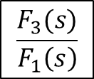







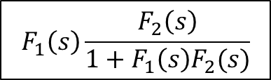



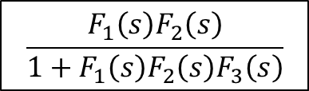
Connecting blocks – not in the book
X(s)
Y(s)
Moving entry point backwards
Moving the exit point forwards
  Divide with the element moved over
$$F_{1}\left(s\right)$$
-
$$F_{2}\left(s\right)$$
$$F_{3}\left(s\right)$$
X(s)
$$F_{1}\left(s\right)\frac{F_{2}\left(s\right)}{1+F_{1}\left(s\right)F_{2}(s)}$$
Y(s)
X(s)
Y(s)
$$F_{1}\left(s\right)$$
$$F_{2}\left(s\right)$$
-
$$\frac{F_{3}(s)}{F_{1}\left(s\right)}$$
X(s)
Y(s)
Moving the entry point forwards
Moving the exit point backwards
  Multiple with the element moved over
$$F_{1}\left(s\right)$$
$$F_{2}\left(s\right)$$
-
$$F_{3}(s)$$
X(s)
$$\frac{F_{1}\left(s\right)F_{2}\left(s\right)}{1+F_{1}\left(s\right)F_{2}\left(s\right)F_{3}\left(s\right)}$$
Y(s)
X(s)
Y(s)
$$F_{1}\left(s\right)F_{2}\left(s\right)$$
-
-
$${F_{1}\left(s\right)F_{2}\left(s\right)F}_{3}(s)$$

Slide 19
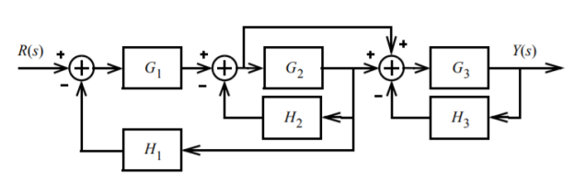
Example

Slide 20
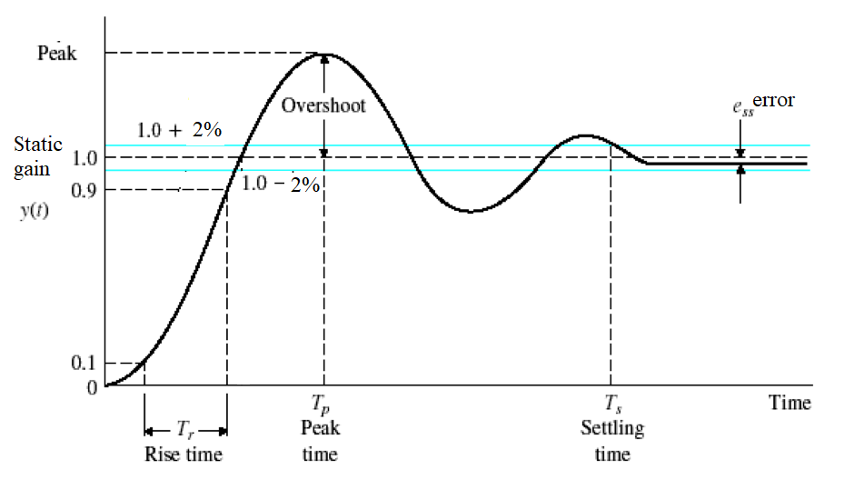
Step response 1

Slide 21
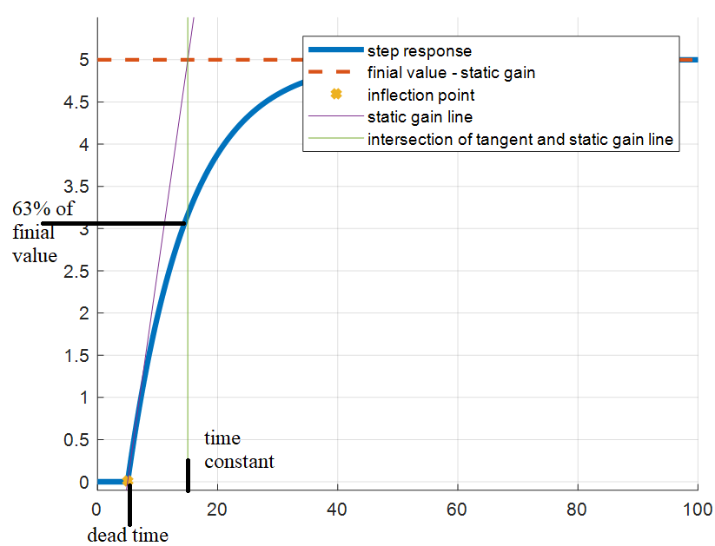
Step response 2

Slide 22
Exercise
http://homepages.vub.ac.be/~pcsurcsi/teaching.html
Typical mistakes
  Simulation time is too short and/or wrong scaling
Useful Matlab commands
  help,
  roots, tf, zpk, pzmap, cumsum,
  series, parallel, feedback,
  lsim, step, impulse, dcgain, stepinfo
  figure, plot, xlim, ylim, title, subplot, legend

Slide 23
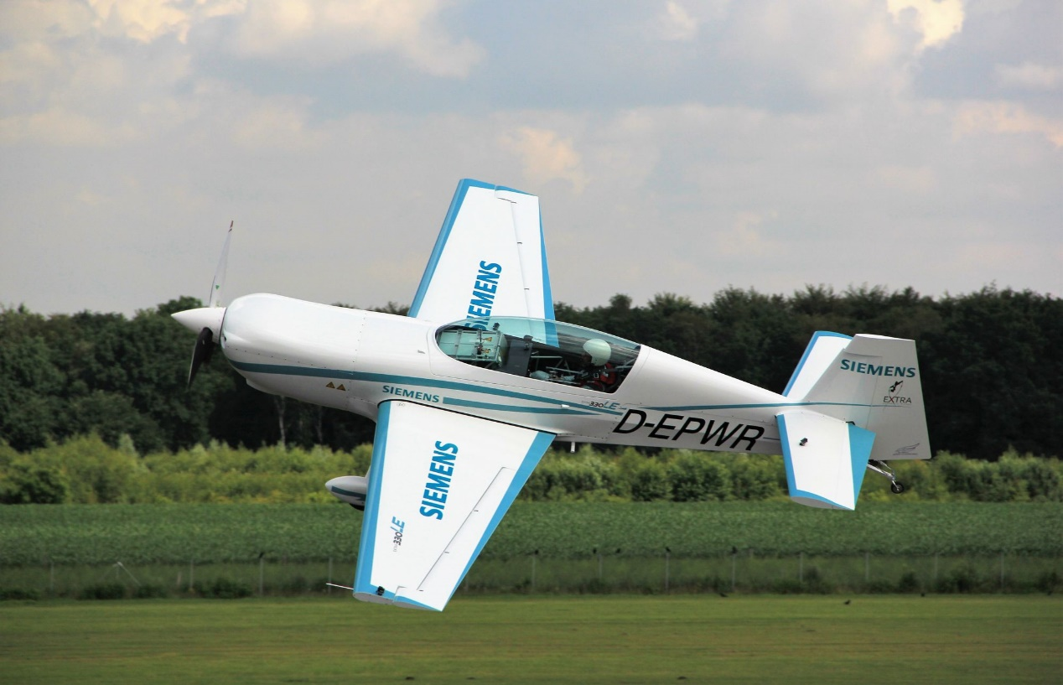
Bode plot - application

Slide 24
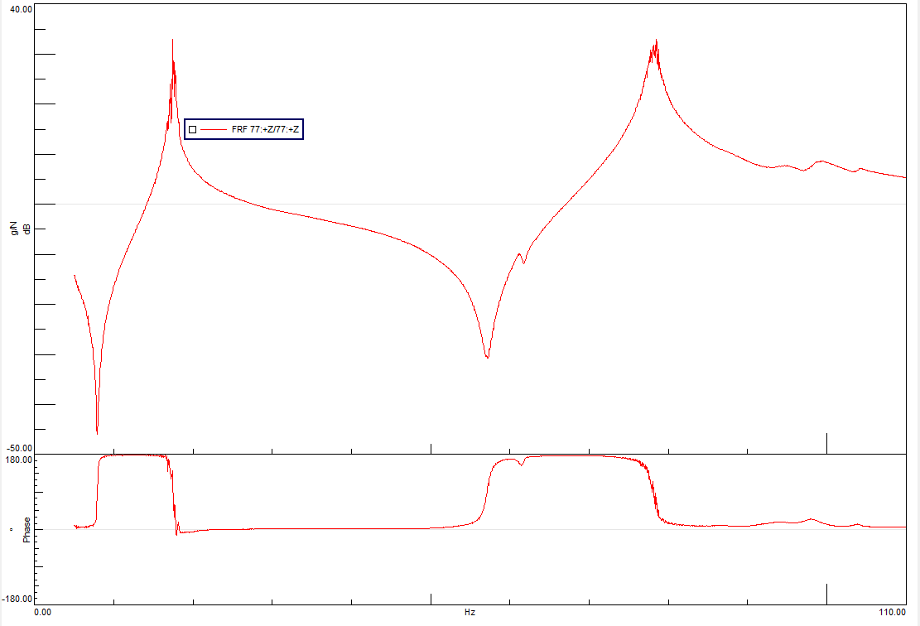
Bode plot - application

Slide 25
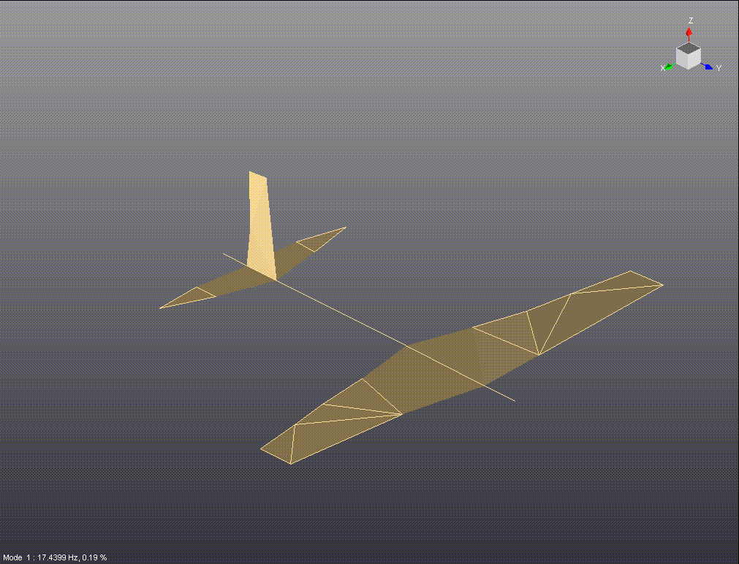
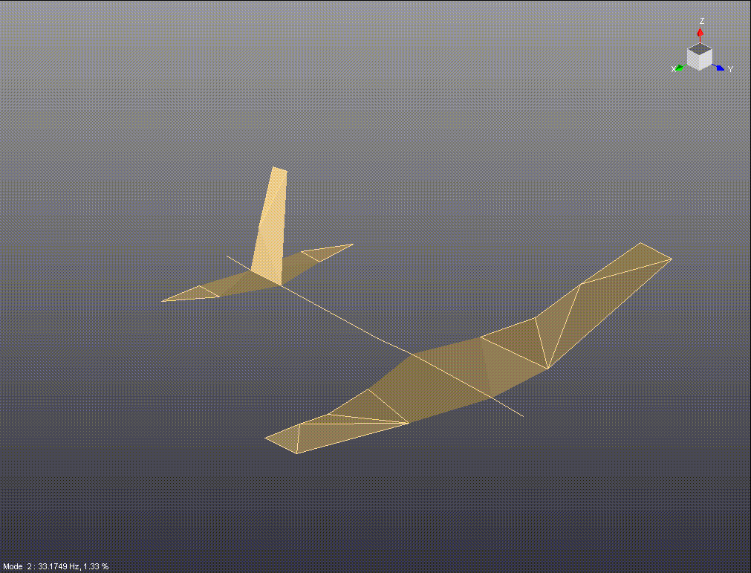
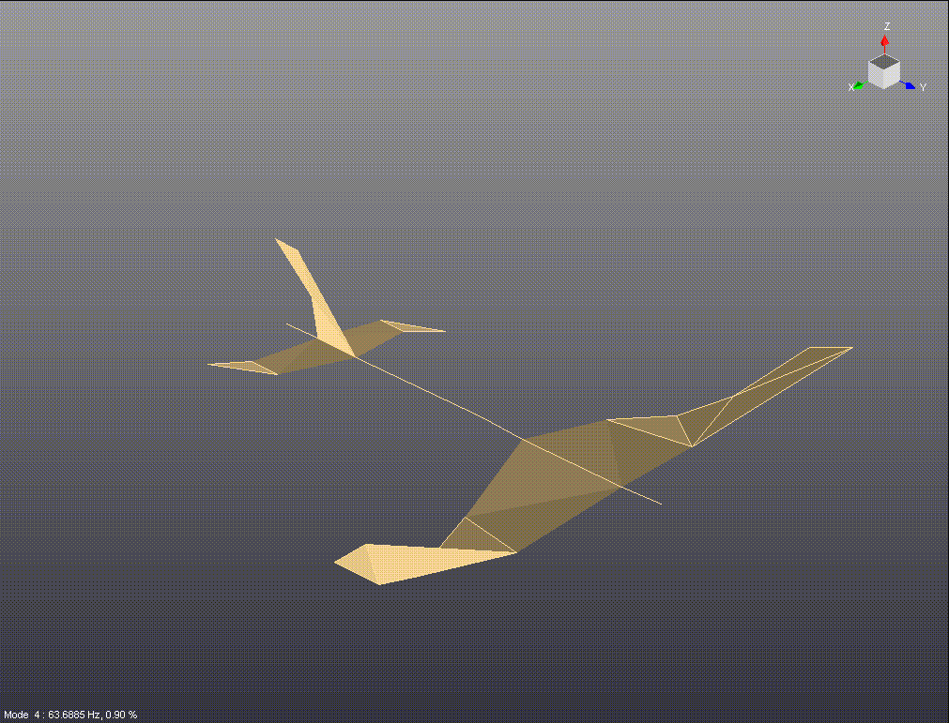
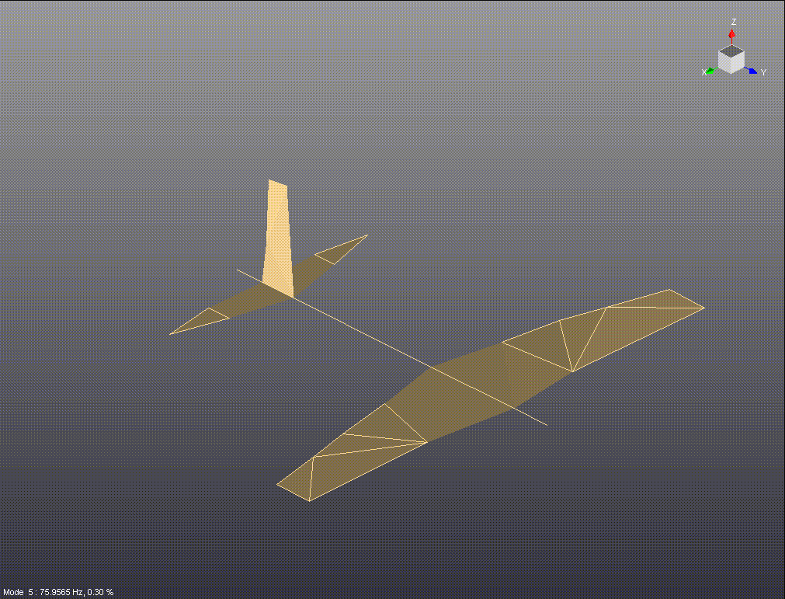

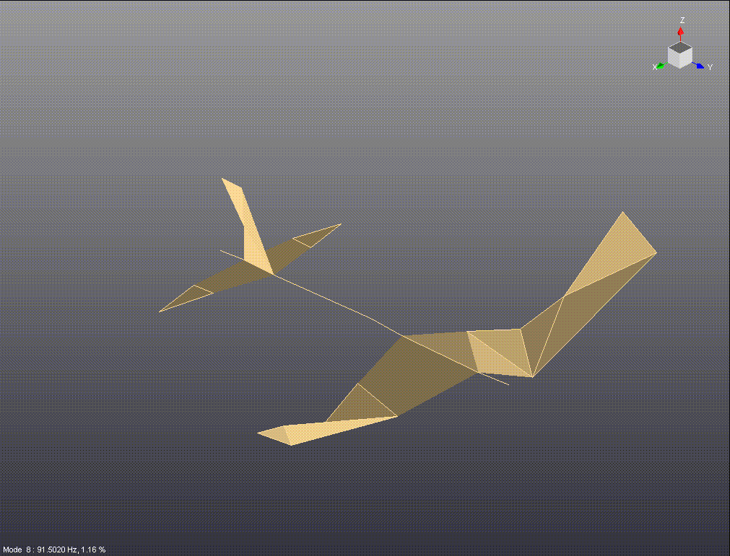
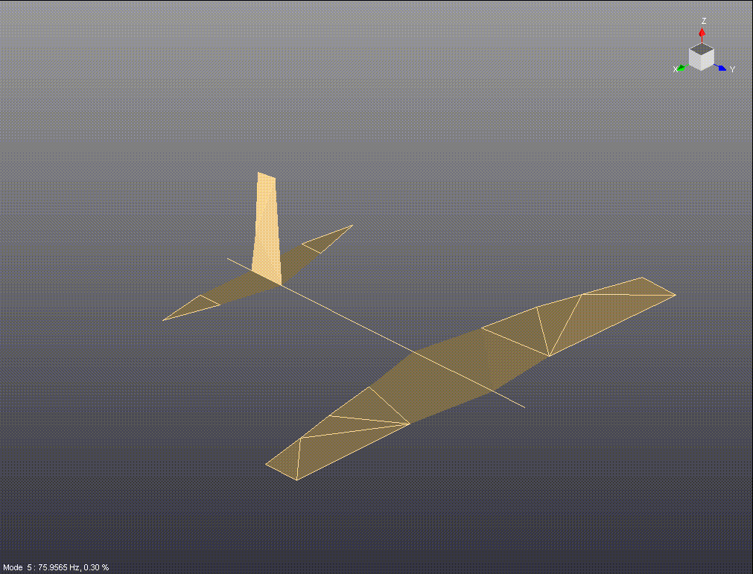

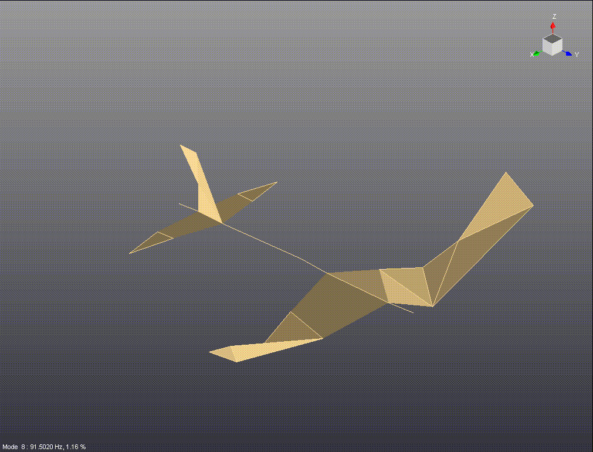



Bode plot - application
17.44 Hz
33.175 Hz
63.688 Hz
75.957 Hz
87.184 Hz
91.502 Hz

Slide 26
P - Proportional term – 0 order tf

Slide 27
I - Integral term
20 dB/D

Slide 28
PI – Proportional Integral term
20 dB/D

Slide 29
D – Derivative term
20 dB/D

Slide 30
Dead time/ delay term

Slide 31
T1 – 1st order term
20 dB/D
45 deg/D

Slide 32
T1 – 1st order term
20 dB/D
45 deg/D

Slide 33
PT1 – Proportional 1st order term
20 dB/D
45 deg/D

Slide 34
T2 – 2nd order term as 2 T1 terms
20 dB/D
40 dB/D
45 deg/D
90 deg/D
45 deg/D

Slide 35
T2 – 2nd order term, zeta=1
40 dB/D
90 deg/D

Slide 36
T2 – 2nd order term, zeta=0.1

Slide 37
T2 – 2nd order term, zeta=0.01

Slide 38
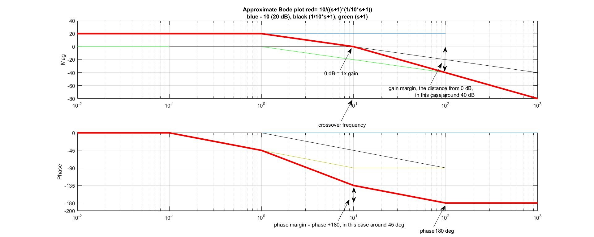
Bode plot…
Static gain (0rad/sec)

Slide 39
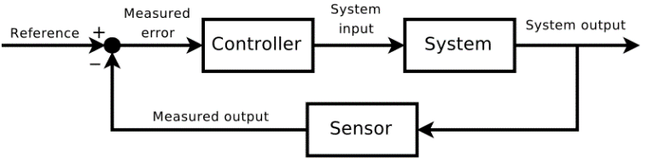


Control example
-3dB
$$3 dB$$
$$\frac{1}{s−1}$$

Slide 40
Control example in Matlab
clear all; close all;
s=tf('s');
H=1/(s-1);
subplot(131); impulse(H)
subplot(132); step(H)
subplot(133); bode(H); grid on
% PM=45 would be at w=1rad/sec; gain=-3.01 dB
K=sqrt(2); %3 dB moving up, 3dB is sqrt(2) in real numbers, 10^(3.01/20)
Hnew=K*H;
H_fb=feedback(Hnew,1);
subplot(131); impulse(H_fb)
subplot(132); step(H_fb)
subplot(133); bode(Hnew); grid on; hold on; bode(H)

Slide 41
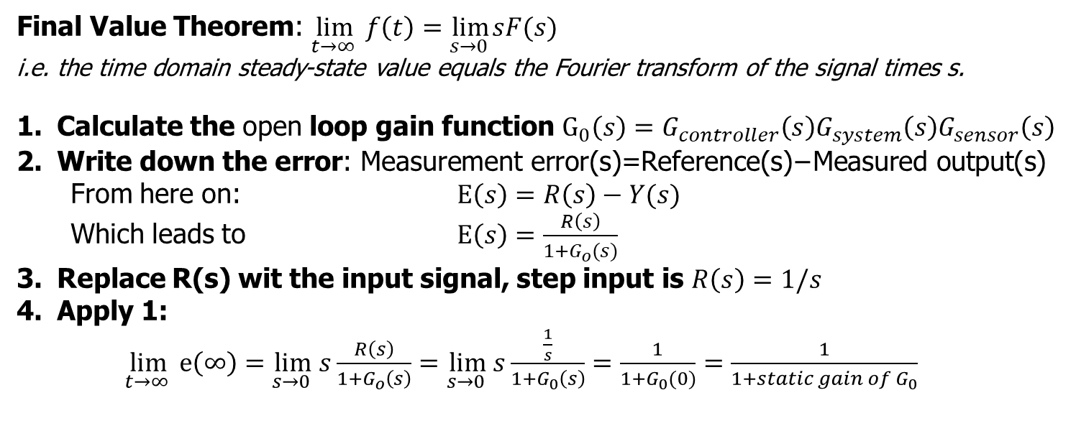
Analytical solution of the steady-state error
Final Value Theorem: $\lim_{t→∞ } f\left(t\right)=\lim_{s→0 }sF(s)$
i.e. the time domain steady-state value equals the Fourier transform of the signal times s.
Calculate the open loop gain function $G_{0}\left(s\right)=G_{controller}\left(s\right)G_{system}\left(s\right)G_{sensor}\left(s\right)$
Write down the error: $\text{Measurement} \text{error}\text{(}\text{s}\text{)=}\text{Reference}\text{(}\text{s}\text{)−}\text{Measured} \text{output}\text{(}\text{s}\text{)}$
  From here on: $E\left(s\right)=R\left(s\right)−Y(s)$
  Which leads to $E\left(s\right)=\frac{R\left(s\right)}{1+G_{o}(s)}$
Replace R(s) wit the input signal, step input is $R\left(s\right)=1/s$
Apply 1:
$\lim_{t→∞ } e\left(∞\right)=\lim_{s→0 }{s\frac{R\left(s\right)}{1+G_{o}\left(s\right)}}=\lim_{s→0 }{s\frac{\frac{1}{s}}{1+G_{0}\left(s\right)}}=\frac{1}{1+G_{0}(0)}=\frac{1}{1+static gain of G_{0}}$

