Slide 1




Regeltechniek WPO –
Control engineering exercises
Dr. ir. Péter Zoltán CSURCSIA, PhD
peter.zoltan.csurcsia@vub.be

Slide 2
WPO 5 sessies
Sessie | Beoordeling | Opmerking
WPO 1 inleiding, whiteboard oefeningen: polen en nullen, stabiliteit, Bodediagram, stapantwoord analyse, Simulink | Toets: 2 p | Een beoordeelde toets voor aanwezigheidscontrole.
WPO 2 Simulink oefeningen, gesloten lus controle, Ziegler-Nichols methoden. | Toets: 2p Werk: 3p | Een groep bevat max. 2 personen. Beoordeelde toets voor aanwezigheidscontrole. Studenten moeten een beoordeelde verslag schrijven.
WPO 3 labo oefening - PID-regeling 2 USB A poorten + Python | Toets: 2p Werk: 3p
WPO 4 PLC – labo oefening Ethernet (LAN)+ Windows | Toets: 1p Werk: 3p
WPO 5 PLC – labo oefening Ethernet (LAN)+ Windows | Toets: 1p Werk: 3p | Studenten moeten een beoordeelde verslag schrijven.
  WPO is 50% van de totaal.
  Overdragen punten naar 2de zit: indien meer dan 10 punten

Slide 3

Rules
  Any kind of cheating results in 0 points
  No copy-paste, no sharing results, no reusing results,
  no discussion with other groups
  Three strikes during exercises
  You can ask always questions, if it is something what you should already know, then you have three strikes, after that -0.1p/question.
  You need to be able to explain and defend your results!
  You cannot explain your results => 0 point
  You wrongly explain your results and can correct => ½ points
  You can explain your miscalculated results and can correct =>full points
  No social media, no messaging, music (not loud) ok

Slide 4
What will we learn?
Very basics only:
  Systems <> models
  Excitation signals
  Some of the most popular analysis techniques:
  Bode plot, step responses…
  Open and closed loop control
Tools
  Whiteboard v2.0
  Simulink toolbox (MATLAB)
  PLC, ball balancing lab exercises

Slide 5
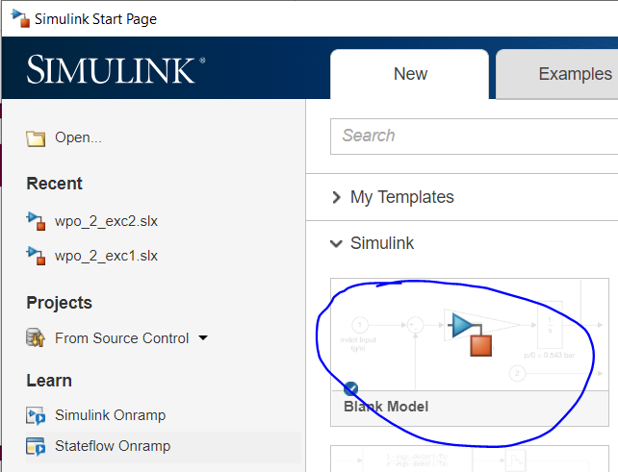

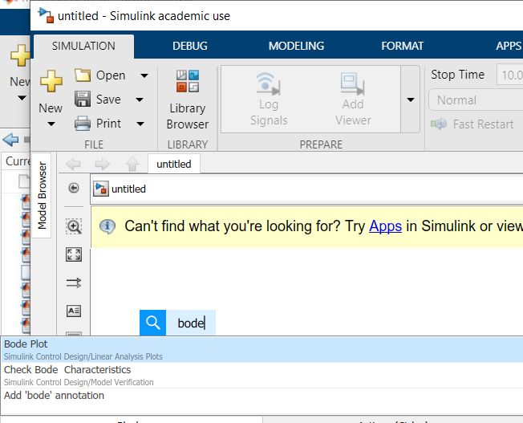

Test your Simulink installation
1
Step 1: type ‘simulink’ <enter>
2
Step 2: create a blank model
Step 3: type ‘bode’ and ‘discrete impulse’ on the workspace. There should be blocks available with these names.
3

Slide 6
About myself
BEng in EE: Instumentation and measurement
BSc in technical informatics
Teacher’s diploma
MSc in embedded systems & applied informatics
PhD and Dr. ir. in (electrical) engineering
  Research area:
    Data-driven modeling (ML + SI)
    Nonlinear systems
    Vibration analysis
    Time-varying systems
    Signal processing

Slide 7
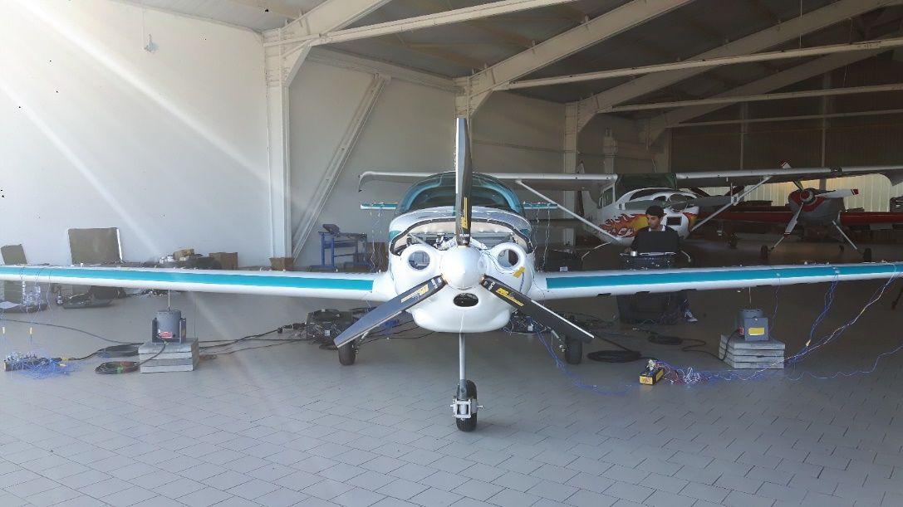
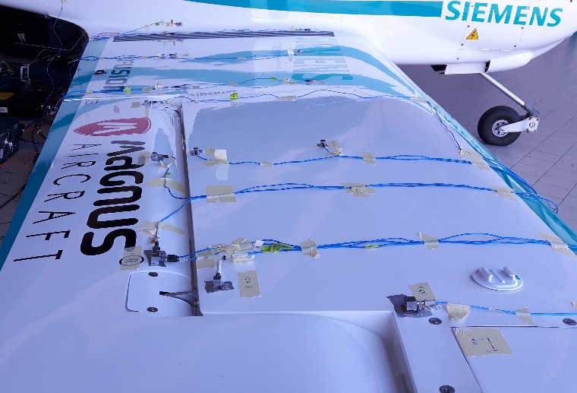
Vibration analysis - nonlinearities
Problem 1: 100+ FRFs
Problem 2: users are not experts
Goal:
Tell the inexperienced users
1) if the system is linear
2) if it is safe to use a linear framework
3) gain in case of a nonlinear model

Slide 8
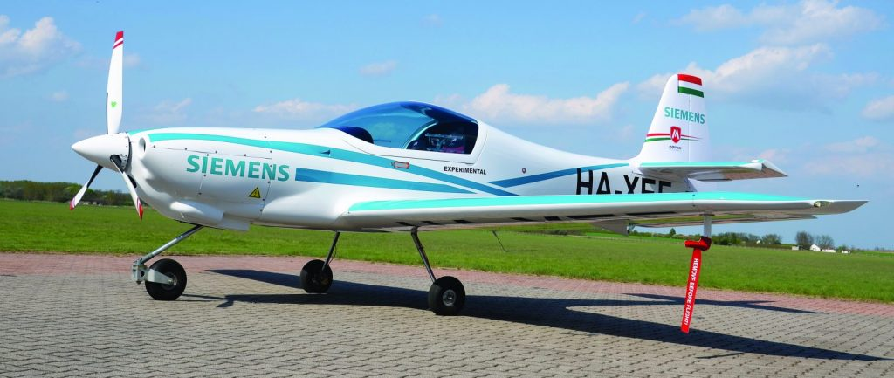
Example: GVT of an airplane
eFusion Magnus aircraft

Slide 9
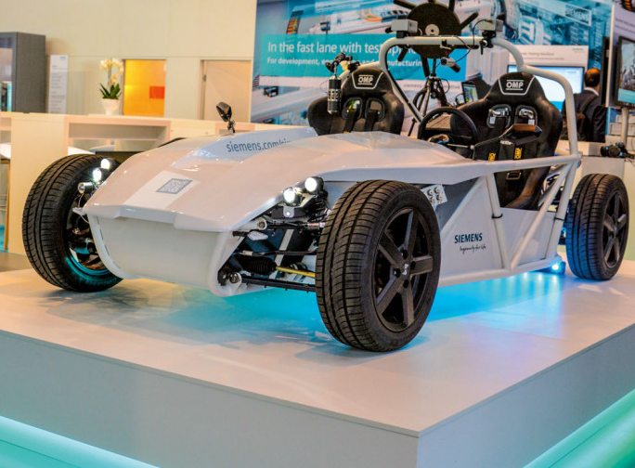
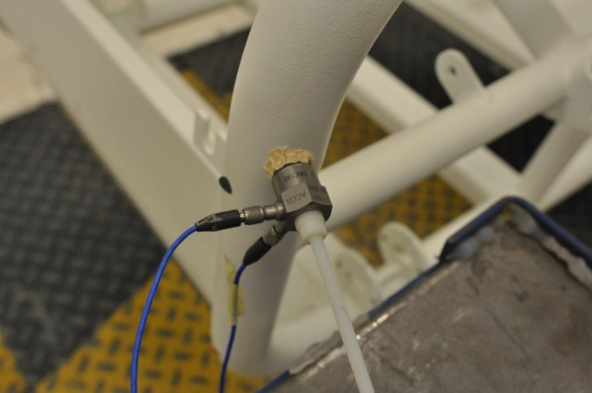
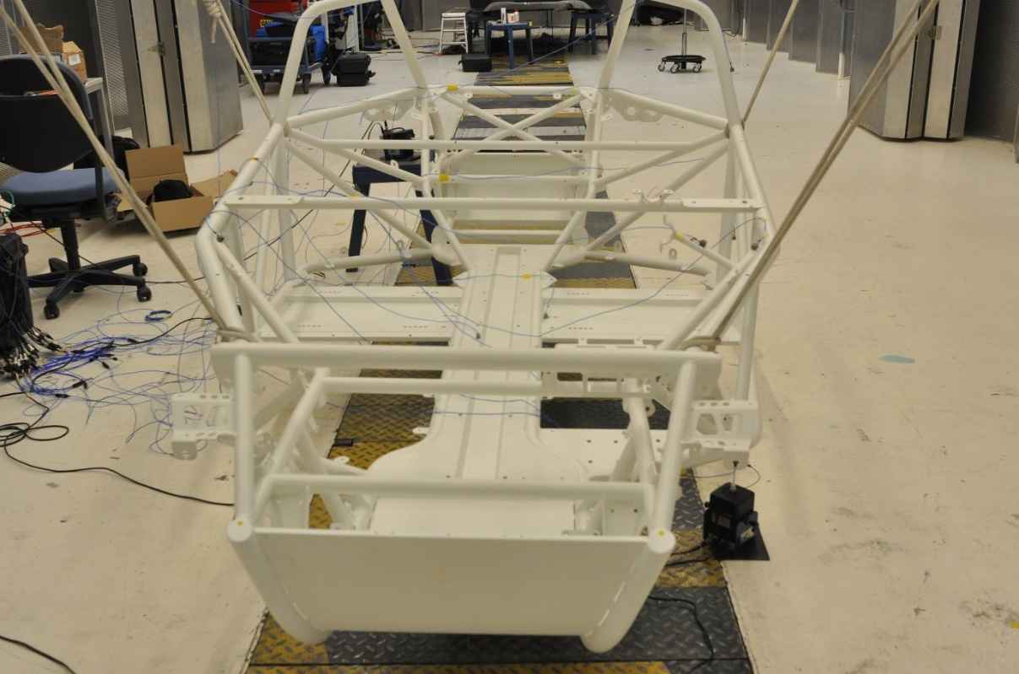
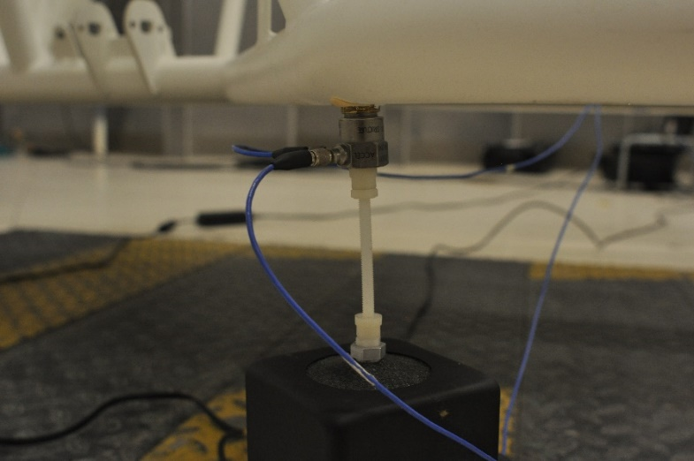
Simroad testing

Slide 10

Transient elimination

Slide 11
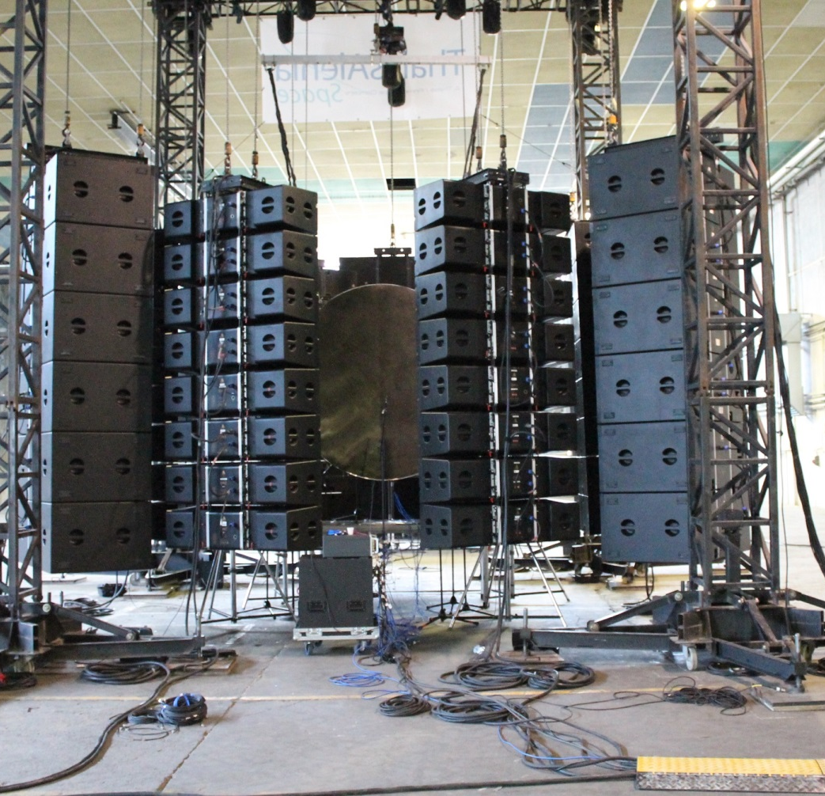
Example: DFAX
Direct Field Acoustic eXcitation issues.
Nonlinearty assesment
Control

Slide 12

Master thesises
http://sysidguy.eu/?page=msc&l=4

Slide 13
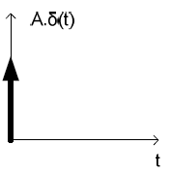
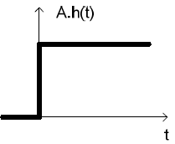
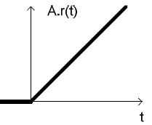
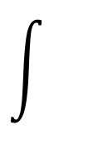
Excitation signals
u
y
SUT
Unit pulse (impulse), u(s)=1
  The area of the impulse is one (A=1)
  Bad SNR
Unit step-signal (heavy-side function), u(s)=1/s
  Old-school, most-often used
  Height of the signal is 1 (A=1)
  Better SNR but high frequencies are not well excited
Unit ramp-signal, u(s)=1/s²
  Slope of the ramp signal is 1 (A=1)
Parabolic
Sine/cosine
Noise
…

Slide 14
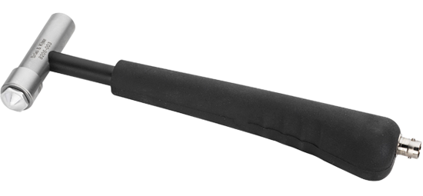

Test – unit pulse
u
y
  Sampling frequency (fs) is 1000 Hz.
SUT
  How much force should we apply for a unit pulse?
  force [N]
A | 0.001 [N]
B | 0.1 [N]
C | 1 [N]
D | 100 [N]
E | 1000 [N]
  ?
sysidguy.eu/vote
  1
  time [ms]

Slide 15
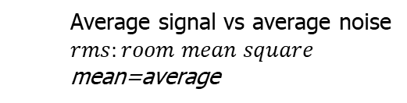
SNR: Signal to Noise Ratio
u
y+n
  In reality,
  ideal signals (y) are measured with noise (n).
  ‘Goodness’ of the measurement is expressed by SNR.
SUT
  Average signal vs average noise
  $rms:room mean square$
  mean=average
  SNR in db = $20\log_{10}{\frac{rms\left(y\right) }{rms(n)}}$
0 dB (1:1, 100%)
20 dB (1:10, 10%)
40 dB (1:100, 1%)
60 dB (1:1000, 0.1%)
80 dB (1:10000)
  Typical values in practice:
  Electrical measurement (e.g. audio filter) in labor: 60-90 dB
  Mechanical measurement (e.g. force) in vehicle testing: 40-60 dB
  Industrial temperature in ovens: 20-30 dB.

Slide 16
Test – unit pulse
u
y
  Sampling frequency (fs) is 1000 Hz.
  Measurement is 1 second long.
  Unit pulse is applied.
  Noise on the measurement ±1 N.
SUT
  How much is the SNR (Signal to Noise Ratio)?
A | 0 dB (1:1)
B | 20 dB (1:10)
C | 40 dB (1:100)
D | 60 dB (1:1000)
E | 80 dB (1:10000)
sysidguy.eu/vote

Slide 17
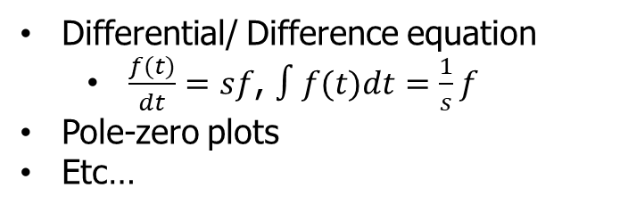
Models in general
Time domain
Fourier
Frequency domain
$$s=jω$$
𝑠=𝑗𝜔
Laplace domain
Laplace
Differential/ Difference equation
State-space equations
Impulse response (measurements)
Step response (measurements)
Ramp response (measurement)
Etc…
Differential/ Difference equation
  $\frac{f(t)}{dt}=sf$, $∫f(t)dt=\frac{1}{s}f$
Pole-zero plots
Etc…
Frequency Response Function
Bode plot
Nyquist plot
Etc…

Slide 18


Models in the WPO session
Time domain
Fourier
Frequency domain
$$S=jω$$
𝑆=𝑗𝜔
Laplace domain
Laplace
Impulse response
Step response
Bode plot
Differential equations
  Transfer function form
  Zero Pole Gain form
Pole-zero plots

Slide 19
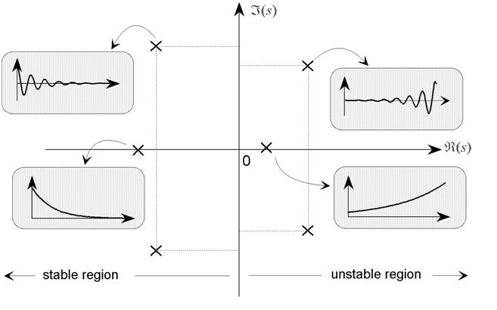
ZP map - stability
Poles (denoted by x) should
be on the left side of the S-plane
Zeros (denoted by o) changes
the shape of the response.
marginally stable
(not stable!)
https://jyotsnaj.wordpress.com/2009/10/01/question-3-what-do-the-poles-and-zeros-contribute-to-in-the-control-system/

Slide 20
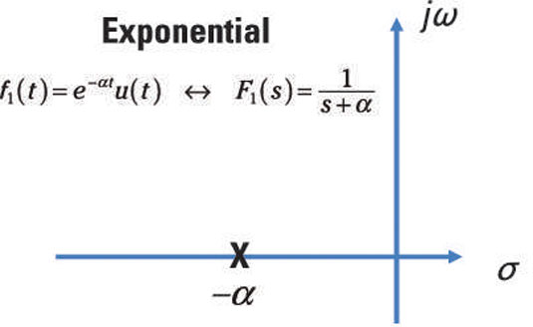
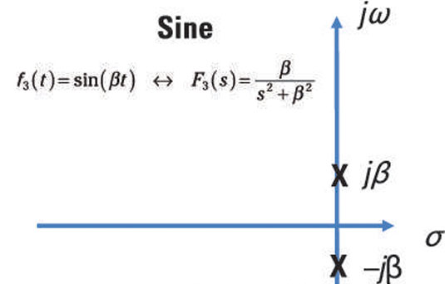
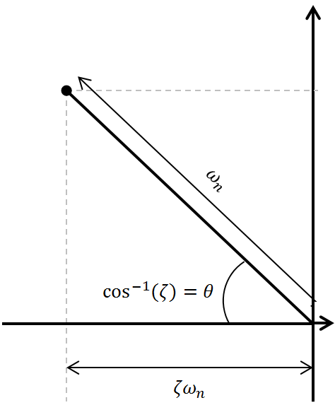
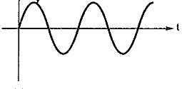
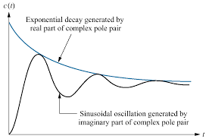
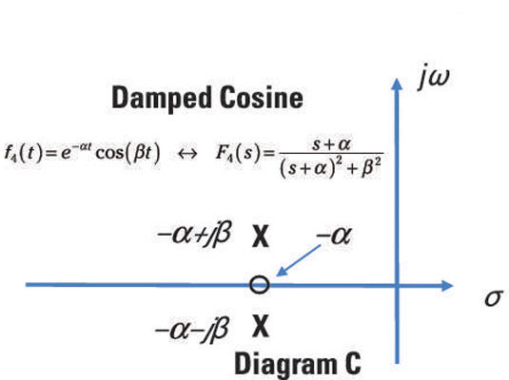

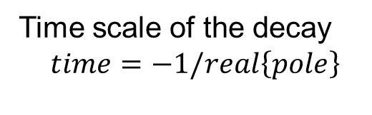
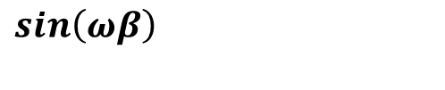
Poles in ZP map
frequency scale of the oscillation
$$sin\left(ωβ\right)$$
Time scale of the decay
$$time=−1/real\left\{pole\right\}$$
$$α$$
Combination
https://www.dummies.com/education/science/science-electronics/s-domain-analysis-understanding-poles-and-zeros-of-fs/

Slide 21
Differential equation example 1a
u
y
SUT
$\frac{d^{2}}{dt^{2}}y(t)+5\frac{d}{t}y(t)+6y(t)=\frac{d}{t}u(t)+3u(t)$
  Questions:
  How do you convert this to s domain?
  What is the transfer function? Order of the system?
  What are the poles and zeros? Stability? ZP map? Simplification
  Natural frequency, time constant, damping factor?
  Time domain plot: impulse and step responses
  Steady-state error (open loop) for impulse and step response
  What is the ZPK (zero pole gain) format? Bode diagram?

Slide 22
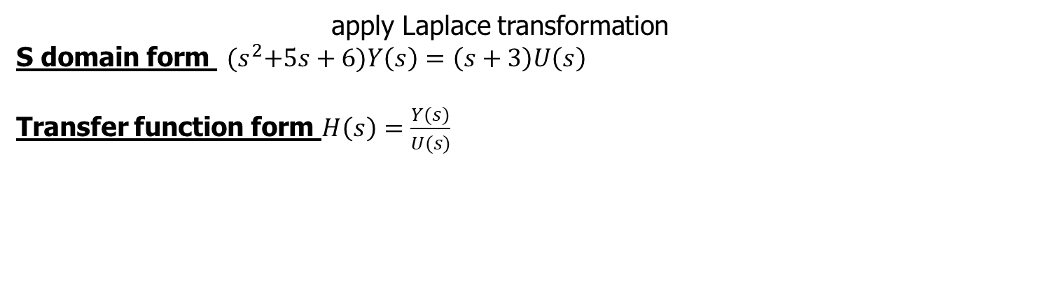
Differential equation example 1a
u
y
SUT
$\frac{d^{2}}{dt^{2}}y(t)+5\frac{d}{t}y(t)+6y(t)=\frac{d}{t}u(t)+3u(t)$
apply Laplace transformation
S domain form ${(s}^{2}+5s+6)Y\left(s\right)=\left(s+3\right)U\left(s\right)$
Transfer function form $H\left(s\right)=\frac{Y(s)}{U(s)}$

Slide 23
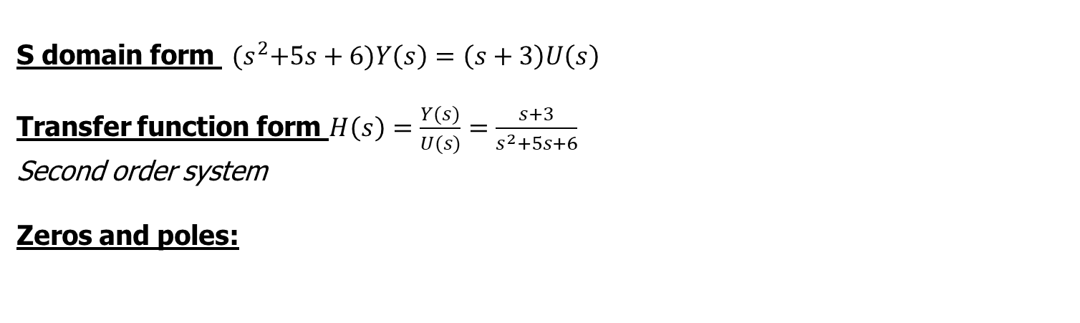
Differential equation example 1a
u
y
SUT
$\frac{d^{2}}{dt^{2}}y(t)+5\frac{d}{t}y(t)+6y(t)=\frac{d}{t}u(t)+3u(t)$
S domain form ${(s}^{2}+5s+6)Y\left(s\right)=\left(s+3\right)U\left(s\right)$
Transfer function form $H\left(s\right)=\frac{Y(s)}{U(s)}=\frac{s+3}{s^{2}+5s+6}$
Second order system
Zeros and poles:

Slide 24
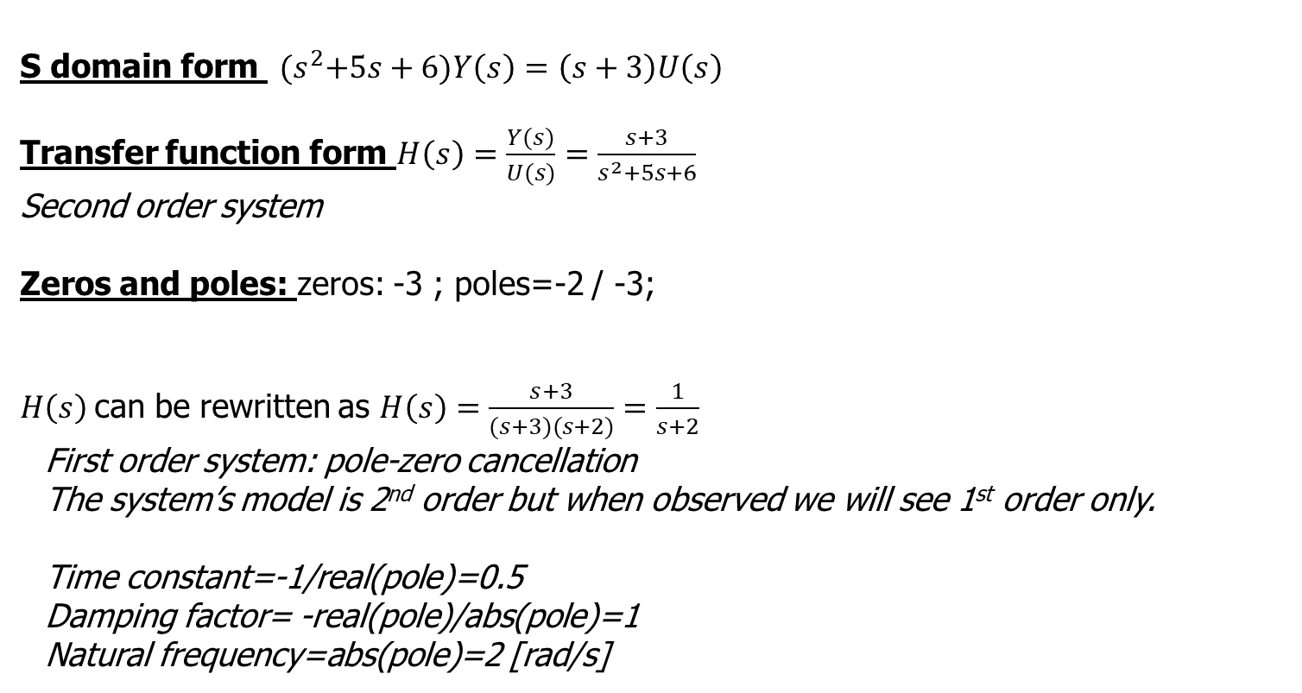
Differential equation example 1a
u
y
SUT
$\frac{d^{2}}{dt^{2}}y(t)+5\frac{d}{t}y(t)+6y(t)=\frac{d}{t}u(t)+3u(t)$
S domain form ${(s}^{2}+5s+6)Y\left(s\right)=\left(s+3\right)U\left(s\right)$
Transfer function form $H\left(s\right)=\frac{Y(s)}{U(s)}=\frac{s+3}{s^{2}+5s+6}$
Second order system
Zeros and poles: zeros: -3 ; poles=-2 / -3;
$H\left(s\right)$can be rewritten as $H\left(s\right)=\frac{s+3}{(s+3)(s+2)}=\frac{1}{s+2}$
  First order system: pole-zero cancellation
  The system’s model is 2nd order but when observed we will see 1st order only.
  Time constant=-1/real(pole)=0.5
  Damping factor= -real(pole)/abs(pole)=1
  Natural frequency=abs(pole)=2 [rad/s]

Slide 25
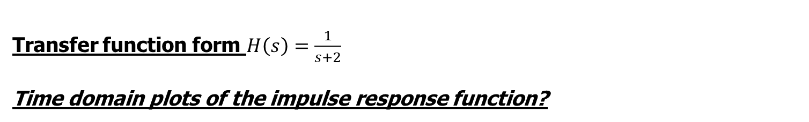


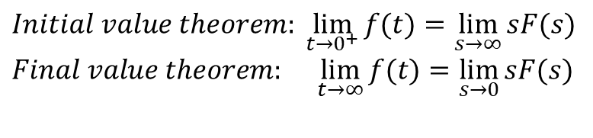
Differential equation example 1a
u
y
SUT
$\frac{d^{2}}{dt^{2}}y(t)+5\frac{d}{t}y(t)+6y(t)=\frac{d}{t}u(t)+3u(t)$
Transfer function form $H\left(s\right)=\frac{1}{s+2}$
Time domain plots of the impulse response function?
$Initial value theorem:\lim_{t→0^{+}}{f(t)}=$ $\lim_{s→∞}{sF(s)}$
$Final value theorem: \lim_{t→∞}{f(t)}=$ $\lim_{s→0}{sF(s)}$
$$Laplace of dirac:U\left(s\right)=1$$
$$Initial value ?$$

Slide 26


Differential equation example 1a
u
y
SUT
$\frac{d^{2}}{dt^{2}}y(t)+5\frac{d}{t}y(t)+6y(t)=\frac{d}{t}u(t)+3u(t)$
Transfer function form $H\left(s\right)=\frac{1}{s+2}$
Time domain plots of the impulse response function?
$Initial value theorem:\lim_{t→0^{+}}{f(t)}=$ $\lim_{s→∞}{sF(s)}$
$Final value theorem: \lim_{t→∞}{f(t)}=$ $\lim_{s→0}{sF(s)}$
$$Laplace of dirac:U\left(s\right)=1$$
$Initial value calculated\lim_{s→∞}{sH(s)}U\left(s\right)=\lim_{s→∞}s\left(\frac{1}{s+2}\right)1=\frac{∞}{∞}=1$
$y(0^{+}$)=1
$$Final value ?$$

Slide 27

Differential equation example 1a
u
y
SUT
$\frac{d^{2}}{dt^{2}}y(t)+5\frac{d}{t}y(t)+6y(t)=\frac{d}{t}u(t)+3u(t)$
Transfer function form $H\left(s\right)=\frac{1}{s+2}$
Time domain plots of the impulse response function?
$Initial value theorem:\lim_{t→0^{+}}{f(t)}=$ $\lim_{s→∞}{sF(s)}$
$Final value theorem: \lim_{t→∞}{f(t)}=$ $\lim_{s→0}{sF(s)}$
$$Laplace of dirac:U\left(s\right)=1$$
$Initial value calculated\lim_{s→∞}{sH(s)}U\left(s\right)=\lim_{s→∞}s\left(\frac{1}{s+2}\right)1=\frac{∞}{∞}=1$
$y(0^{+}$)=1
$Final value calculated\lim_{s→0}{sH(s)}U\left(s\right)=\lim_{s→0}s\left(\frac{1}{s+2}\right)1=\frac{0}{0}=0$
$y(∞$)=0

Slide 28





Differential equation example 1a
u
y
SUT
$\frac{d^{2}}{dt^{2}}y(t)+5\frac{d}{t}y(t)+6y(t)=\frac{d}{t}u(t)+3u(t)$
Transfer function form $H\left(s\right)=\frac{1}{s+2}$
Time domain plots of the impulse response function?
$Initial value theorem:\lim_{t→0^{+}}{f(t)}=$ $\lim_{s→∞}{sF(s)}$
$Final value theorem: \lim_{t→∞}{f(t)}=$ $\lim_{s→0}{sF(s)}$
$$Laplace of dirac:U\left(s\right)=1$$
$$Initial value$$
$y(0^{+}$)=1
$$Final value$$
$y(∞$)=0
$Time constant$=-1/real(pole)=0.5 sec

Slide 29

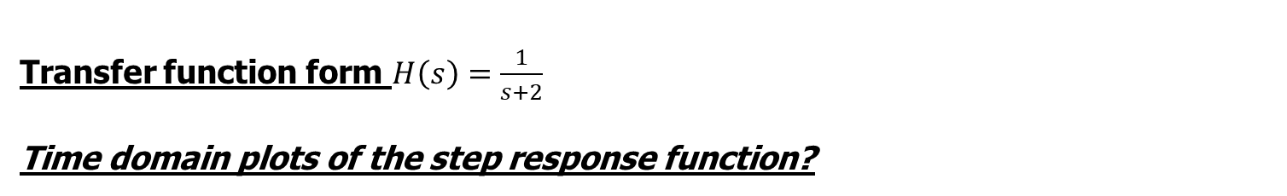


Differential equation example 1a
u
y
SUT
$\frac{d^{2}}{dt^{2}}y(t)+5\frac{d}{t}y(t)+6y(t)=\frac{d}{t}u(t)+3u(t)$
Transfer function form $H\left(s\right)=\frac{1}{s+2}$
Time domain plots of the step response function?
$Initial value theorem:\lim_{t→0^{+}}{f(t)}=$ $\lim_{s→∞}{sF(s)}$
$Final value theorem: \lim_{t→∞}{f(t)}=$ $\lim_{s→0}{sF(s)}$
$$Laplace of step:U\left(s\right)=1/s$$
$$Initial value$$
$$?$$
$$Final value$$
$$?$$
$Time constant$=-1/real(pole)=0.5 sec
  at this time is the step response $at 63\%$

Slide 30


Differential equation example 1a
u
y
SUT
$\frac{d^{2}}{dt^{2}}y(t)+5\frac{d}{t}y(t)+6y(t)=\frac{d}{t}u(t)+3u(t)$
Transfer function form $H\left(s\right)=\frac{1}{s+2}$
Time domain plots of the step response function?
$Initial value theorem:\lim_{t→0^{+}}{f(t)}=$ $\lim_{s→∞}{sF(s)}$
$Final value theorem: \lim_{t→∞}{f(t)}=$ $\lim_{s→0}{sF(s)}$
$$Laplace of step:U\left(s\right)=1/s$$
$$Initial value$$
$$0$$
$$Final value$$
$$0.5$$
  = static gain = H(s=0)
$Time constant$=-1/real(pole)=0.5 sec
  at this time is the step response $at 63\%$
  Simulation/measurement time should be at least 10-times larger than the dominant time constant.

Slide 31
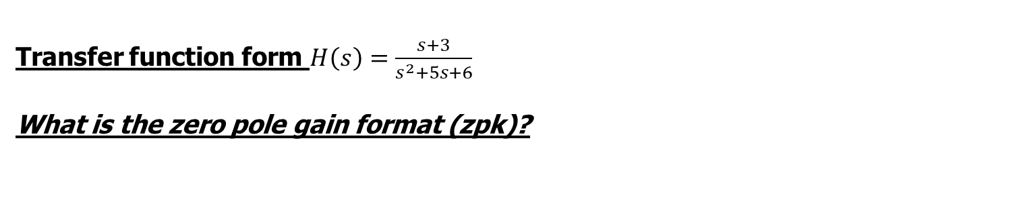
Differential equation example 1a
u
y
SUT
$\frac{d^{2}}{dt^{2}}y(t)+5\frac{d}{t}y(t)+6y(t)=\frac{d}{t}u(t)+3u(t)$
Transfer function form $H\left(s\right)=\frac{s+3}{s^{2}+5s+6}$
What is the zero pole gain format (zpk)?

Slide 32
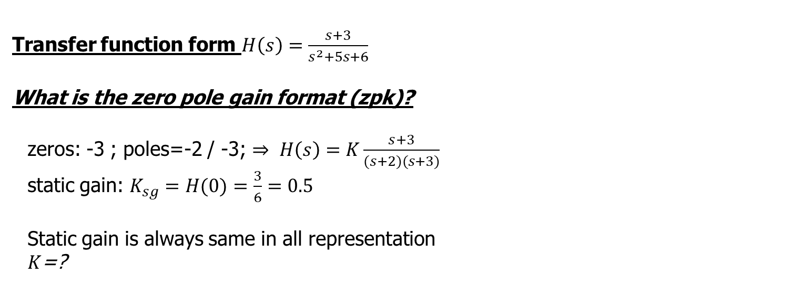
Differential equation example 1a
u
y
SUT
$\frac{d^{2}}{dt^{2}}y(t)+5\frac{d}{t}y(t)+6y(t)=\frac{d}{t}u(t)+3u(t)$
Transfer function form $H\left(s\right)=\frac{s+3}{s^{2}+5s+6}$
What is the zero pole gain format (zpk)?
  zeros: -3 ; poles=-2 / -3; $⇒ H\left(s\right)=K\frac{s+3}{(s+2)(s+3)}$
  static gain: $K_{sg}=H(0)=\frac{3}{6}=0.5$
  Static gain is always same in all representation
  $K$=?

Slide 33

Differential equation example 1a
u
y
SUT
$\frac{d^{2}}{dt^{2}}y(t)+5\frac{d}{t}y(t)+6y(t)=\frac{d}{t}u(t)+3u(t)$
Transfer function form $H\left(s\right)=\frac{s+3}{s^{2}+5s+6}$
What is the zero pole gain format (zpk)?
  zeros: -3 ; poles=-2 / -3; $⇒ H\left(s\right)=1\frac{(s+3)}{(s+2)(s+3)}$
  static gain: $K_{sg}=H(0)=\frac{3}{6}$
  Static gain is always same in all representation
  $K$=1

Slide 34
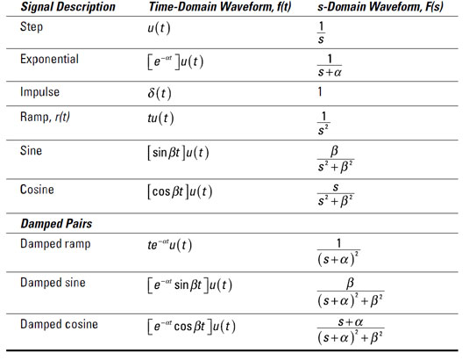
Some Laplace transform pairs

Slide 35
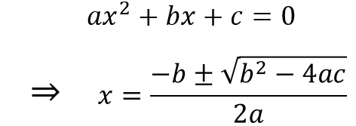
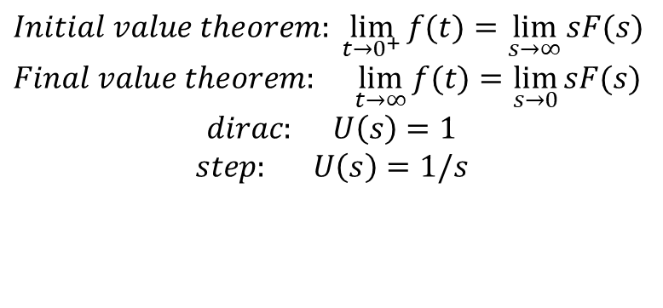
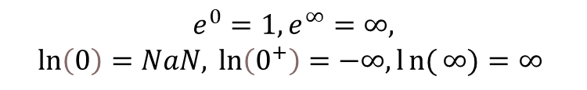
Example 2
  Transfer function $H\left(s\right)=\frac{10s+10}{s^{2}+4s+5}e^{−5s}$
  Questions:
  What are the poles and zeros? Stability? ZP map? Simplification?
  Time domain plot: impulse and step responses (static gain!)
$Initial value theorem:\lim_{t→0^{+}}{f(t)}=$ $\lim_{s→∞}{sF(s)}$
$Final value theorem: \lim_{t→∞}{f(t)}=$ $\lim_{s→0}{sF(s)}$
$$dirac: U\left(s\right)=1$$
$$step: U\left(s\right)=1/s$$
$$e^{0}=1,e^{∞}=∞,$$
$$\ln\left(0\right)=NaN, \ln\left(0^{+}\right)=−∞, ln{(}∞)=∞$$

Slide 36
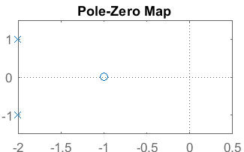
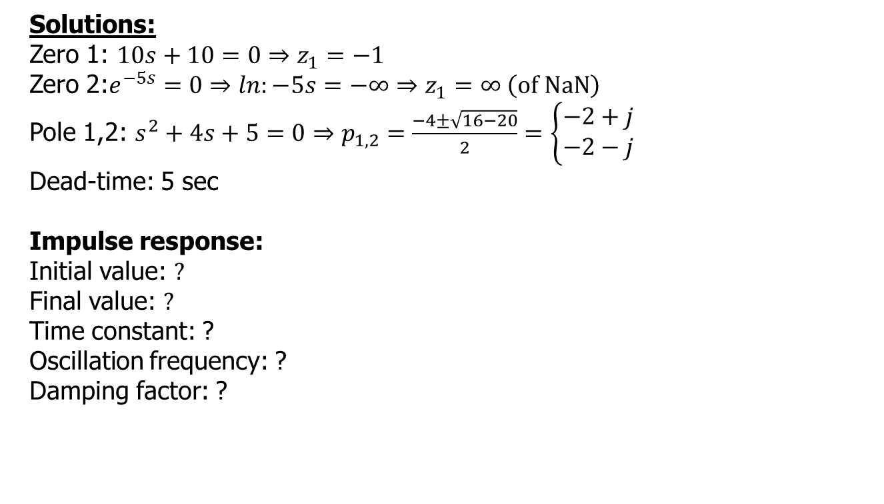

Example 2
  $$H\left(s\right)=\frac{10s+10}{s^{2}+4s+5}e^{−5s}$$
  Solutions:
  Zero 1: $10s+10=0⇒z_{1}=−1$
  Zero 2:$e^{−5s}=0⇒ln:−5s=−∞⇒z_{1}=∞ \left(of NaN\right)$
  Pole 1,2: $s^{2}+4s+5=0⇒p_{1,2}=\frac{−4±\sqrt{16−20}}{2}=\left\{\begin{matrix}−2+j \\ −2−j\end{matrix}\right.$
  Dead-time: 5 sec
  Impulse response:
  Initial value: $?$
  Final value: $?$
  Time constant: ?
  Oscillation frequency: ?
  Damping factor: ?

Slide 37
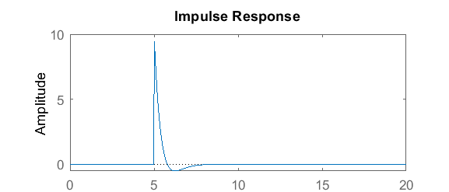
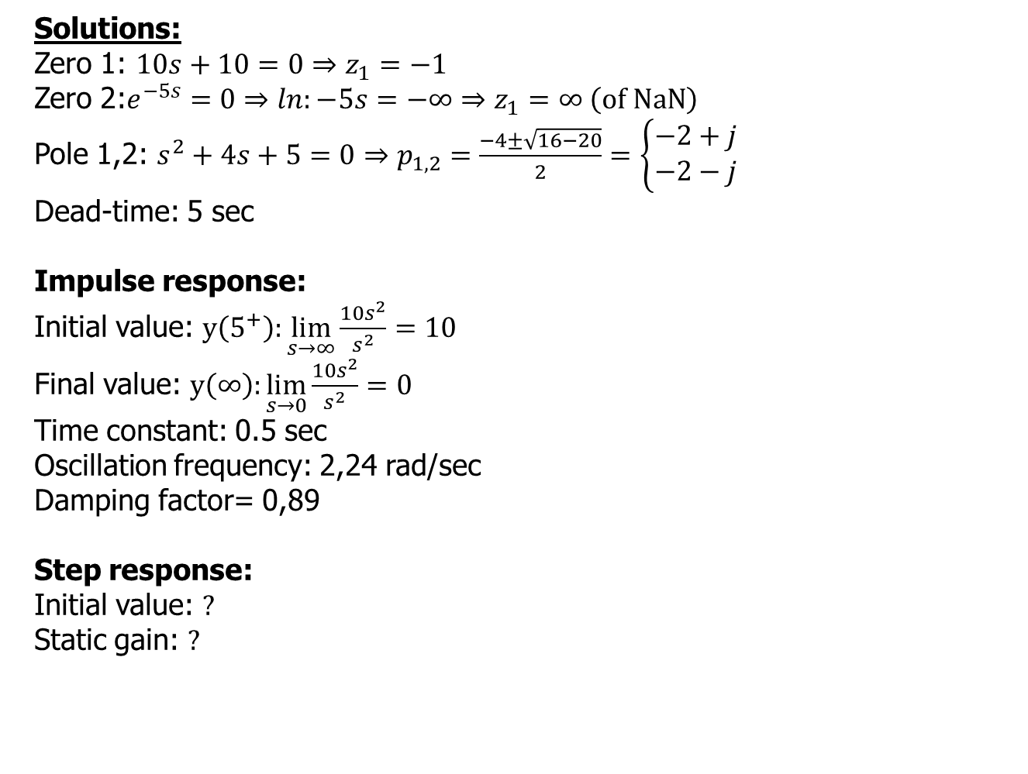
Example 2
  $$H\left(s\right)=\frac{10s+10}{s^{2}+4s+5}e^{−5s}$$
  Solutions:
  Zero 1: $10s+10=0⇒z_{1}=−1$
  Zero 2:$e^{−5s}=0⇒ln:−5s=−∞⇒z_{1}=∞ \left(of NaN\right)$
  Pole 1,2: $s^{2}+4s+5=0⇒p_{1,2}=\frac{−4±\sqrt{16−20}}{2}=\left\{\begin{matrix}−2+j \\ −2−j\end{matrix}\right.$
  Dead-time: 5 sec
  Impulse response:
  Initial value: $y\left(5^{+}\right):\lim_{s→∞}{\frac{10s^{2}}{s^{2}}=10}$
  Final value: $y\left(∞\right):\lim_{s→0}{\frac{10s^{2}}{s^{2}}=0}$
  Time constant: 0.5 sec
  Oscillation frequency: 2,24 rad/sec
  Damping factor= 0,89
  Step response:
  Initial value: $?$
  Static gain: $?$

Slide 38
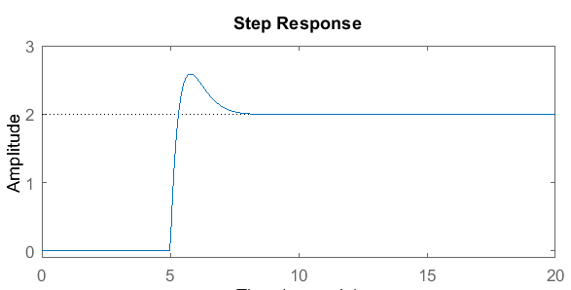
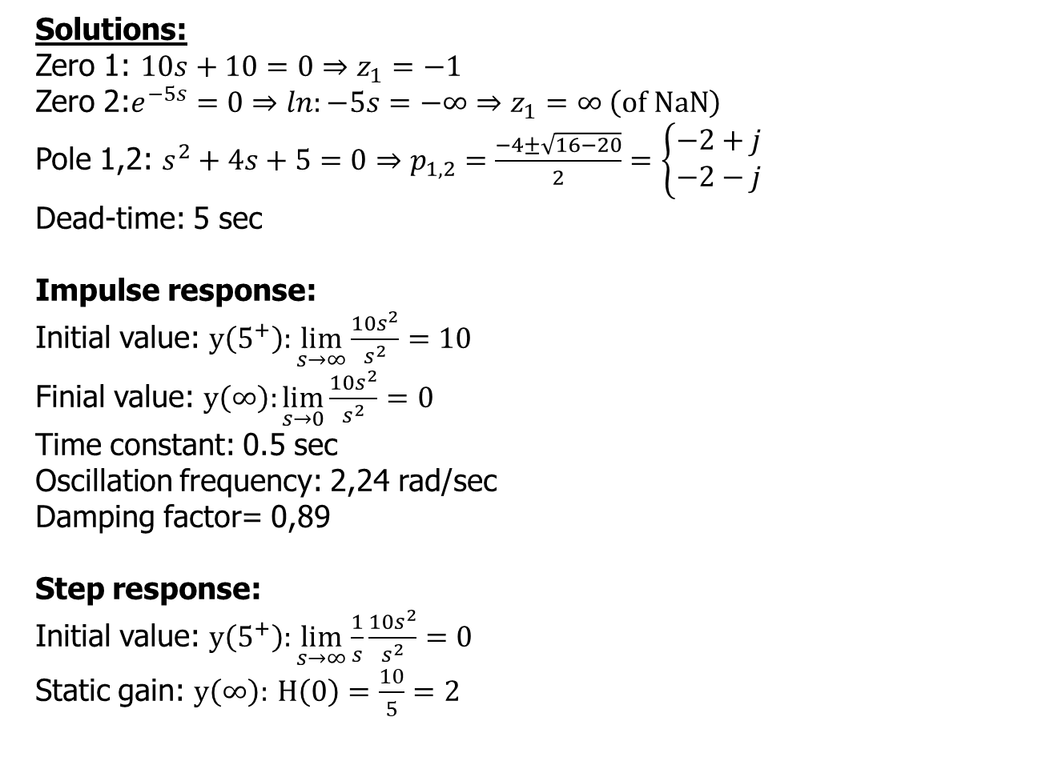
Example 2
  $$H\left(s\right)=\frac{10s+10}{s^{2}+4s+5}e^{−5s}$$
  Solutions:
  Zero 1: $10s+10=0⇒z_{1}=−1$
  Zero 2:$e^{−5s}=0⇒ln:−5s=−∞⇒z_{1}=∞ \left(of NaN\right)$
  Pole 1,2: $s^{2}+4s+5=0⇒p_{1,2}=\frac{−4±\sqrt{16−20}}{2}=\left\{\begin{matrix}−2+j \\ −2−j\end{matrix}\right.$
  Dead-time: 5 sec
  Impulse response:
  Initial value: $y\left(5^{+}\right):\lim_{s→∞}{\frac{10s^{2}}{s^{2}}=10}$
  Finial value: $y\left(∞\right):\lim_{s→0}{\frac{10s^{2}}{s^{2}}=0}$
  Time constant: 0.5 sec
  Oscillation frequency: 2,24 rad/sec
  Damping factor= 0,89
  Step response:
  Initial value: $y\left(5^{+}\right):\lim_{s→∞}{\frac{1}{s}\frac{10s^{2}}{s^{2}}=0}$
  Static gain: $y\left(∞\right):$ $H\left(0\right)=\frac{10}{5}=2$

Slide 39
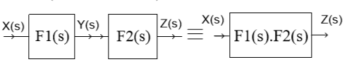
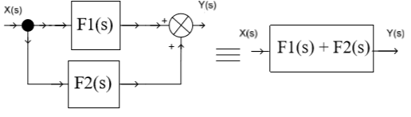
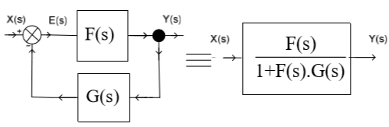
Connecting blocks - book
Serial connection (cascading)
  Products of the elements
Parallel connection
  Sum of the elements
Feedback

Slide 40
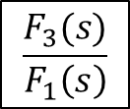







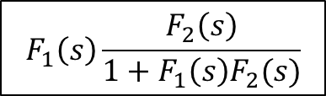




Connecting blocks
X(s)
Y(s)
Moving entry point backwards
Moving the exit point forwards
  Divide with the element moved over
$$F_{1}\left(s\right)$$
-
$$F_{2}\left(s\right)$$
$$F_{3}\left(s\right)$$
X(s)
$$F_{1}\left(s\right)\frac{F_{2}\left(s\right)}{1+F_{1}\left(s\right)F_{2}(s)}$$
Y(s)
X(s)
Y(s)
$$F_{1}\left(s\right)$$
$$F_{2}\left(s\right)$$
-
$$\frac{F_{3}(s)}{F_{1}\left(s\right)}$$
X(s)
Y(s)
Moving the entry point forwards
Moving the exit point backwards
  Multiple with the element moved over
$$F_{1}\left(s\right)$$
$$F_{2}\left(s\right)$$
-
$$F_{3}(s)$$
X(s)
$$\frac{F_{1}\left(s\right)F_{2}\left(s\right)}{1+F_{1}\left(s\right)F_{2}\left(s\right)F_{3}\left(s\right)}$$
Y(s)
X(s)
Y(s)
$$F_{1}\left(s\right)F_{2}\left(s\right)$$
-
-
$${F_{1}\left(s\right)F_{2}\left(s\right)F}_{3}(s)$$

Slide 41

Simplification example

Slide 42
Simplification example
1+D

Slide 43
Simplification example
1+D+I

Slide 44
Simplification example
KH(1+D+I)

Slide 45

Simplification example
$$\frac{\text{KH}\text{(1+}\text{D}\text{+}\text{I}\text{)}}{\text{1+}\text{FKH}\text{(1+}\text{D}\text{+}\text{I}\text{)}}$$

Slide 46
Simplification example
$$\frac{\text{KH}\text{(1+}\text{D}\text{+}\text{I}\text{)}}{\text{1+}\text{FKH}\text{(1+}\text{D}\text{+}\text{I}\text{)}}$$
Characteristic
polynomial
loop gain (function)

Slide 47

Simplification example - advanced
Solution is given
http://sysidguy.eu/regeltechniek/plant_simplify.pdf

Slide 48



Example
u(t)=4*h(t)
$$5$$
-
$$\frac{1}{s+2}$$
$$\frac{8}{s+4}$$
  Steady-state values:
  Reference signal (R)?
  Process value (PV)?
  Static error?
  Measured process value (MPV)?
  Error signal?

Slide 49

Example
u(t)=4*h(t)
  20
  10
  5
$$5$$
-
$$\frac{1}{s+2}$$
  10
$$\frac{8}{s+4}$$
  Steady-state values:
  Reference signal (R)? 4*5=20
  Process value (PV)? 20*(1/2)/(1+(1/2)(8/4))=5
  Static error? 4-5=-1
  Measured process value (MPV)? PV*(8/4)=10
  Error signal? R-MPV=10

Slide 50


Step response 1
Static gain= $K_{p}=\frac{Δy}{Δu}=\frac{y(∞)−y\left(0\right)}{u(∞)−u\left(0\right)}$ when unity step response, 0 starting value $Kp=y\left(∞\right)$
Overshoot$: \left(max\left(y\right)−y\left(∞\right)\right)/y\left(∞\right)∗100 [\%]$ (undershoot: min(y))

Slide 51

Step response 2

Slide 52

Unit step response – example
  Order of the system: ?
  Static gain: ?
  Settling time: ?
  Rise time: ?
  Overshoot: ?
  Dead time: ?
  Time constant: ?
  Steady-state error: ?

Slide 53
Unit step response – example
  Order of the system: 1 (probably)
  Static gain: 0.5
  Settling time: ?
  Rise time: ?
  Overshoot: ?
  Dead time: ?
  Time constant: ?
  Steady-state error: ?

Slide 54
Unit step response – example
  Order of the system: 1 (probably)
  Static gain: 0.5
  Settling time: 1.9 sec
  Rise time: around 1.2 sec (1.3-0.1)
  Overshoot: ?
  Dead time: ?
  Time constant: ?
  Steady-state error: ?

Slide 55
Unit step response – example
  Order of the system: 1 (probably)
  Static gain: 0.5
  Settling time: 1.9 sec
  Rise time: around 1.2 sec (1.3-0.1)
  Overshoot: 0 % ([0.5-0.5]/0.5*100)
  Dead time: 0
  Time constant: around 0.5 sec (amplitude is near 0.5*63%=0,315)
  Steady-state error: 0.5

Slide 56
Step response – example 2
  Order of the system: ?
  Static gain: ?
  Settling time: ?
  Rise time: ?
  Overshoot: ?
  Dead time: ?
  Time constant: ?
  Steady-state error: ?

Slide 57
Step response – example 2
  Order of the system: probably 2
  Static gain: 2 [=(6-2)/(3-1)]
  Settling time: ?
  Rise time: ?
  Overshoot: ?
  Dead time: ?
  Time constant: ?
  Steady-state error: ?

Slide 58
Step response – example 2
  Order of the system: probably 2
  Static gain: 2 [=(6-2)/(3-1)]
  Settling time: around 7.2 sec
  Rise time: around 0.28 sec (5.3-5.02)
  Overshoot: 20% [(7.2-6)/6*100]
  Dead time: ?
  Time constant: ?
  Steady-state error: ?

Slide 59
Step response – example 2
  Order of the system: probably 2
  Static gain: 2 [=(6-2)/(3-1)]
  Settling time: around 7.2 sec
  Rise time: around 0.28 sec (5.3-5.02)
  Overshoot: 20% [(7.2-6)/6*100]
  Dead time: 5 sec
  Time constant: 0.2 sec (=5.2-5 [dead time!], 63% of the jump 4=> 2.5]
  Steady-state error: 3 (6-3)

Slide 60

Bode plot - application

Slide 61

Bode plot - application

Slide 62












Bode plot - application
17.44 Hz
33.175 Hz
63.688 Hz
75.957 Hz
87.184 Hz
91.502 Hz

Slide 63

Test – Bode diagram
Consider the closed loop system with the following components.
What elements are used to plot the Bode function?
A | Controller*System
B | Controller*System*Sensor
C | System
D | Controller*System/ (1+Controller*System*Sensor)

Slide 64


Measurement of Bode diagram
Consider the manual measurement of the Bode plot.
Which signal would you apply?
A | Pulse
B | Square
C | Ramp
D | Sine
E | none of the above
SUT

Slide 65

Bode plot – units
u
y
SUT
Magnitude $H\left(jω\right)=20∗\log_{10}\left|\frac{Y}{U}\right|=20∗\log_{10}\left|\frac{Y^{2}}{U^{2}}\right|=\left[dB\right]$
Phase P$\left(jω\right)=\arg\left|H\right|=arctng\frac{Imag\left\{H\left(jω\right)\right\}}{Real\left\{H\left(jω\right)\right\}}$ [deg or rad]

Slide 66
Bode plot – frequency scale
Rad/sec or Hz (other units are also possible)
Normalized of absolute
Decade (log10), octave (log8), linear, etc.

Slide 67


Bode plot – useful derivations
Advantage of logarithmic scale: $\log{\frac{AB}{C}=\log{A}+\log{B}−\log{C}}$
Magnitude to dB: $db=20\log_{10}{A} \left(for signal\right)$
dB to Magnitude: $A={10}^{dB/20}$
Phase: 180 deg = 1 Pi
Frequency omega [rad]=>2*pi*F [Hz]

Slide 68
Bode plot – useful derivations
Idea of behind stability - Closed loop equation
characteristic polynomial
Unstable if F(s)G(s)=-1
db(|1|)=0
-1 =>-180 deg
Loop gain (function)
F(s)G(s)
Manual drawing examples
http://sysidguy.eu/regeltechniek/bode_by_hand.pptx

Slide 69
Bode plot overview - quantities
Static gain = DC gain: magnitude of H(s→0)=>H(jω→0)

Slide 70
Bode plot overview - quantities
Time constants – frequencies - Poles/Zeros:
Check the frequencies at ±3 dB*n at the breaking point (bandwidth)
n order of the system
-3 dB
-3 dB
Middle point of phase change

Slide 71

Bode plot overview - quantities
Time constants – frequencies - Poles/Zeros:
Check the frequencies at ±3 dB at the breaking point (bandwidth)
  Minimum sampling frequency?
A | f_{L}
B | f_{U}
C | 2*f_{L}
D | 2*f_{U}
E | 2*B

Slide 72
Bode plot overview - quantities
(gain) cross-over frequency: where the magnitude crosses 0 dB
Phase margin: 180 deg – phase at cross-over
phase
margin
cross-over frequency

Slide 73
Bode plot overview - quantities
phase cross-over frequency: where the phase crosses 180 deg
gain margin: -(magnitude at phase cross-over)
gain
margin
phase cross-over frequency

Slide 74

Bode plot overview - stability
In practice, stable if PM>45 deg and gm>0

Slide 75
P - Proportional term – 0 order tf

Slide 76
I - Integral term
20 dB/D

Slide 77
PI – Proportional Integral term
20 dB/D

Slide 78
D – Derivative term
20 dB/D

Slide 79
Dead time/ delay term

Slide 80
T1 – 1st order term
20 dB/D
45 deg/D

Slide 81
T1 – 1st order term
20 dB/D
45 deg/D

Slide 82
PT1 – Proportional 1st order term
20 dB/D
45 deg/D

Slide 83
T2 – 2nd order term as 2 T1 terms
20 dB/D
40 dB/D
45 deg/D
90 deg/D
45 deg/D

Slide 84
T2 – 2nd order term, zeta=1
40 dB/D
90 deg/D

Slide 85
T2 – 2nd order term, zeta=0.1

Slide 86
T2 – 2nd order term, zeta=0.01

Slide 87
Bode example 1
Order of system=?
Type of system=?
Static gain=?
Pole frequency=?
Cross-over fr.=?
Phase margin=?
Gain margin=?
Stable=?

Slide 88
Bode example 2
Order of system=?
Type of system=?
Static gain=?
Pole frequency=?
Cross-over fr.=?
Phase margin=?
Gain margin=?
Stable=?

Slide 89
Simulink exercises

Slide 90
Exercise
Some various materials from previous year: http://sysidguy.eu/index.php?page=teaching2021&l=4
Typical mistakes
  Simulation time is too short and/or wrong scaling

Slide 91

Bode diagram block
Make sure you use open-loop signals
Use exact delay should be ticked (otherwise your dead-time is not shown correctly)

Slide 92


Solver options
The sampling frequency (sampling time) can be set by modifying the solver parameters (fixed step size, see the icon on the bottom right corner of the Simulink window).

Slide 93

System $H\left(s\right)=\frac{s+3}{s^{2}+5s+6}$ with f_{s}=100 Hz
Realize the system in Simulink.
Calculate the zeros and poles yourself. Plot the poles and zeros in Simulink and compare with your results. What is the dominant time constant?
Simulate a unit step response excitation. Choose an appropriate time interval for the simulation (based on the time constant). The sampling frequency (sampling time) can be set by modifying the solver parameters (fixed step size).
Plot the step response. Quantify the step response: static gain, rise time, settling time, peak-time, dominant time constant.
Show clearly on your plot how you estimate the different quantities
Display the Bode plot. Analyze: static gain, time constants (which one is the dominant one), gain margin, phase margin, cross-over frequency.
How do you obtain the step response if only the impulse response is available? Simulate the impulse response (hint: use discrete impulse block). Compare the step response and the step response estimate from the impulse response, show that they are equal.
$$solution is on my website ;)$$

Slide 94



Closed loop control
a) Realize the systems with the following parameters
$G_{controller}\left(s\right)=1, G_{system}\left(s\right)=\frac{1}{s−2}, G_{sensor}\left(s\right)=1$
Is the open-loop system stable? Show the unit step response.
Is the closed-loop system stable? Show the unit step response.
b) Display the Bode plot of the underlying system.
Estimate the gain margin, phase margin, crossover frequency using the Bode plot figure.
c) Design a closed loop P controller. What gain is needed? Why? Define the controller accordingly.
$$H_{0}\left(s\right)=\frac{K}{s−2+K};pole=K−2$$
$$same information can be read from the Bode plot ;)$$

