Slide 1
Regeltechniek WPO – Exercise 1
Ziegler-Nichols open loop method

Slide 2
Regeltechniek WPO - Exercise 2
Ziegler-Nichols closed loop method

Slide 3
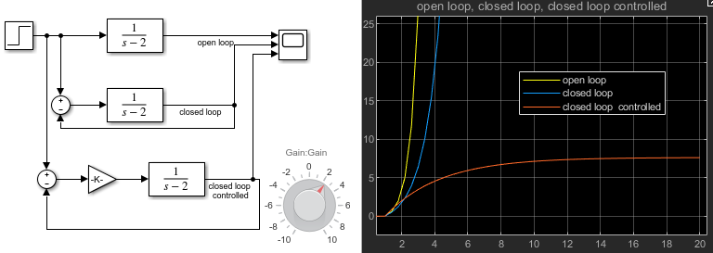
Regeltechniek WPO - Exercise 3
Making stable $H\left(s\right)=\frac{1}{s−2}$
$$H\left(s\right)=\frac{1}{s−2};pole=+2$$

Slide 4
Regeltechniek WPO - Exercise 3
Making stable $H\left(s\right)=\frac{1}{s−2}$
$$H\left(s\right)=\frac{1}{s−2};pole=+2$$
$$H_{0}\left(s\right)=\frac{1}{s−1};pole=+1$$

Slide 5
Regeltechniek WPO - Exercise 3
Making stable $H\left(s\right)=\frac{1}{s−2}$
$$H\left(s\right)=\frac{1}{s−2};pole=+2$$
$$H_{0}\left(s\right)=\frac{1}{s−1};pole=+1$$
$$H_{0}\left(s\right)=\frac{K}{s−2+K};pole=K−2$$
$$same information can be read from the Bode plot ;)$$

